Slide 1
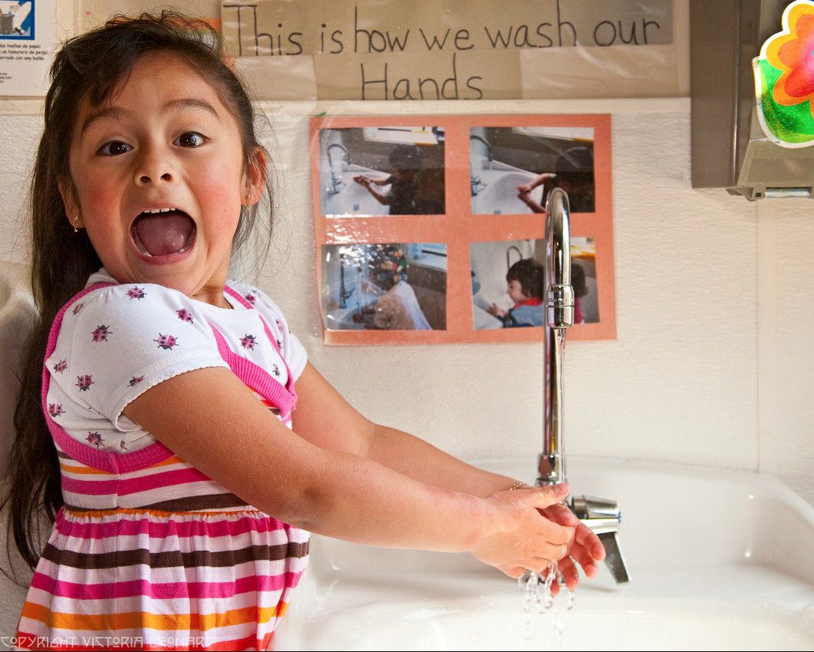
Green Cleaning, Sanitizing and Disinfection: A Toolkit for Early Care and Education

Slide 2




Who We Are
This Green Cleaning, Sanitizing and Disinfecting Toolkit for Early Care and Education was developed by a team of public health professionals, health educators, nurses, and policy makers both in California and across the nation. The principle organizations involved in its development are:
Funding for this project has been provided in full or in part through a grant awarded by the California Department of Pesticide Regulation (DPR). The contents of this document do not necessarily reflect the views and policies of DPR nor does mention of trade names or commercial products constitute endorsement or recommendation for use.

Slide 3
Icebreaker Questions
What’s your name?
What is the most important thing you do to prevent the transmission of infectious diseases in your ECE program?
What concerns do you have about cleaning, sanitizing and disinfecting?
What would you like to learn from today’s workshop?
Notes:
What do these products mean to you?

Slide 4
Why Are We Here Today?
Our Goal: To protect the health of children and staff in ECE and the environment

Slide 5
Why is Green Cleaning, Sanitizing, and Disinfecting So Important in the ECE Environment?
Children are more sensitive than adults to the health effects of toxic chemicals in the environment.
Up to one-third of childhood cancer is due to environmental causes.
Health effects from exposure to environmental toxins may not show up for years or even decades

Slide 6
Why is Green Cleaning, Sanitizing, and Disinfecting So Important in the ECE Environment?
Pregnant women, often on staff in ECE, and their unborn babies, are particularly vulnerable to the health effects of hazardous products used in ECE.
“Precautionary Principle”

Slide 7
By the End of Today, You Will
Be Able To:
Recognize the hazards of group care for young children
  provides ideal conditions for the transmission of infectious disease.
Protect young children (and coworkers) from infectious diseases
  the harmful health effects of hazardous products
Choose and use the least harmful products to clean, sanitize and disinfect.

Slide 8
Today’s Information
Understand how behaviors can reduce the risk of infectious disease as well as, or better than, chemical products.
Start your own Green Cleaning, Sanitizing and Disinfecting Program.

Slide 9
ToolkiT OVERVIEW
The Toolkit includes:
  A Green Cleaning, Sanitizing and Disinfecting for Early Care and Education curriculum booklet
  4 Posters
  9 stand alone fact sheets for ECE providers
  2 fact sheets for families

Slide 10
Tool Kit Overview
  A Choosing Green Cleaners, Sanitizers and Disinfectants Wallet Card
  A Green Cleaning, Sanitizing and Disinfecting Checklist to help you develop and maintain a Green Cleaning, Sanitizing and Disinfecting Program

Slide 11
Information in the Toolkit
Policies and protocols for:
  establishing a green cleaning program
  purchasing and using safer cleaning and disinfecting products
  negotiating a contract for cleaning services with an outside vendor

Slide 12
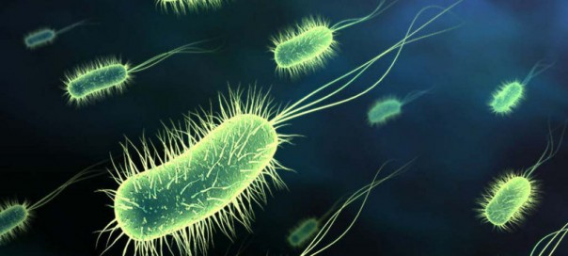
What are Infectious Diseases?
Infectious diseases are:
spread by germs (also called microbes) from one person (or animal) to another
are very common in ECE.
Studies show that young children in ECE have symptoms of illness one third to one half of the days out of the year! This is normal.

Slide 13
What Types of Germs Are There?
There are several kinds of germs we are concerned about in the ECE environment:
  Bacteria
  Viruses
  Fungi
  Parasites
These germs get into our bodies in different ways.
Notes:
Viruses are the most common cause of illness. They are very small. Viruses can’t live on surfaces for a long time.
Bacteria are more complex than viruses. They can live and reproduce independently. Some can survive on surfaces for a long time, feeding off dirt or food and water. Most are harmless or even beneficial to us.
Fungi are yeasts and molds and they are everywhere. They can survive for long periods on surfaces and in the environment. Yeast can cause many common skin infections

Slide 14
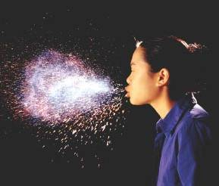
How are Infectious Diseases Spread?
Bacteria and viruses are
found in body fluids, including:
  Blood
  Mucus
  Saliva
  Vomit
  Stool (feces)
Discharges from the eyes and skin sores or wounds
A good rule to remember: if it's wet and comes from someone's body, it can be infectious!
Notes:
Viruses are the most common cause of illness. They are very small. Viruses can’t live on surfaces for a long time.
Bacteria are more complex than viruses. They can live and reproduce independently. Some can survive on surfaces for a long time, feeding off dirt or food and water. Most are harmless or even beneficial to us.
Fungi are yeasts and molds and they are everywhere. They can survive for long periods on surfaces and in the environment. Yeast can cause many common skin infections

Slide 15
Infectious Diseases Pose Risks to Young Children in ECE
They get sick more often, and are hospitalized more often when they do get sick, compared to children cared for at home.
Parents must also take time off from work to care for them.
In the U.S. families who have children in child care lose 13 days of work a year because of infections.
Infectious diseases pose risks to ECE staff as well.

Slide 16
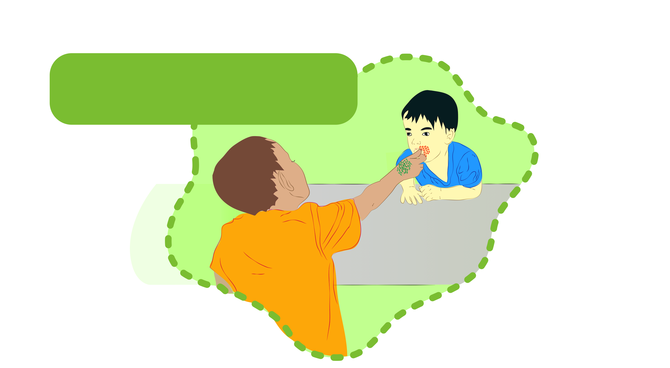
Infectious Diseases Pose Risks to Young Children in ECE
1.) Direct contact: body fluids are directly transferred from one person to another. Examples of direct contact are touching, kissing and sex.

Slide 17

Infectious Diseases Pose Risks to Young Children in ECE
2.) Droplets: when kids sneeze, cough, spit, drool, slobber or vomit into the air and then land on another person or a hard surface. This is how flu is spread!

Slide 18
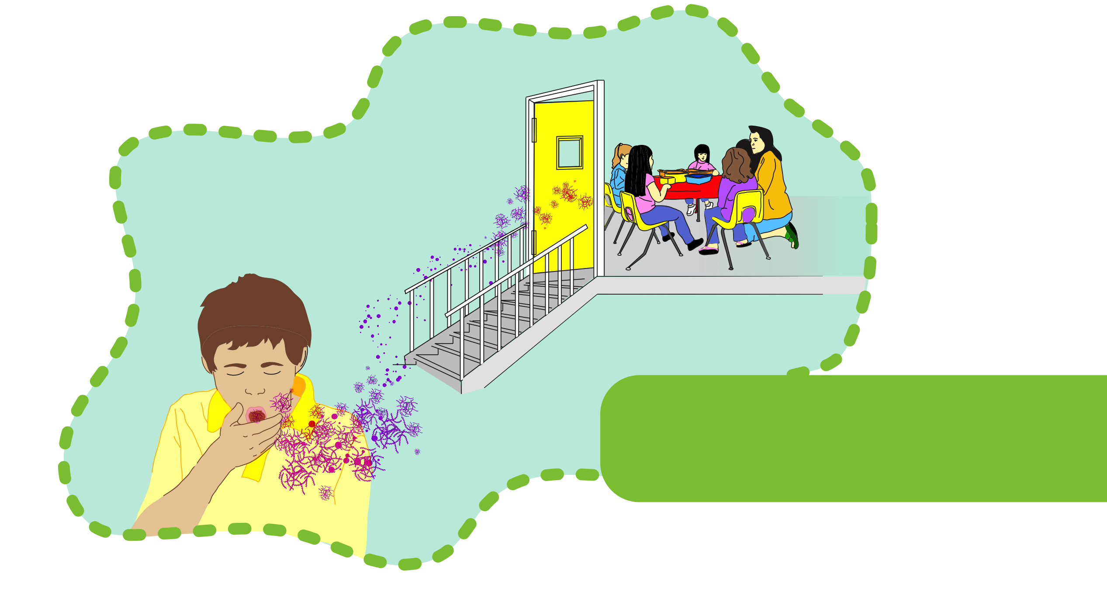
Infectious Diseases Pose Risks to Young Children in ECE
3.) Airborne transmission: germs that float suspended in the air attached to moisture droplets or dust particles, and travel more than 3 feet.

Slide 19
Steps to Reduce the Spread of Infectious Disease
Development of formal written policies for reducing the risk of infectious disease, including vaccination of children and staff.
Formal education of child care center staff concerning infection control
Good hand hygiene by both staff and children
Appropriate cleaning and targeted disinfection, when necessary, of contaminated surfaces
Separation of food preparation, toileting and diaper changing activities

Slide 20
Other Ways Germs Spread
Fecal oral transmission: Germs in the stool of one infected person make their way into the mouth of another person. These germs usually cause vomiting and diarrhea.
Blood: Many of the germs that can be found in blood can cause life-threatening disease when an infected person’s blood enters another person’s body through a break in the skin.
Insects: can carry bacteria and viruses and can transmit them when they bite humans.

Slide 21
How Can We Reduce the Spread of Infectious Disease?
By cleaning, sanitizing, and disinfecting, we do several things, including:
  Cleaning, which washes germs down the drain
  Sanitizing and disinfecting with chemicals or devices that kill germs.

Slide 22
How Can We Reduce the Spread of Infectious Disease?
  By our personal behaviors, we can reduce the spread of disease when we:
    Wash our hands to remove germs so we don’t transfer them to others.
    Stay home when we are ill
    Cover our coughs and sneeze into our sleeves. Germs get caught in our clothing instead, where they don’t live very long!

Slide 23
Why is it Important to Clean and Sanitize in ECE Centers?
Why do we clean?...
The physical environment is especially important for young children.
  They breathe more air for their size, compared to adults.
  Their skin touches the ground (where harmful chemicals collect) much more than an adult.
  They absorb harmful chemicals through their skin, which is thinner than an adult’s.
  They stick a lot of objects in their mouths.

Slide 24
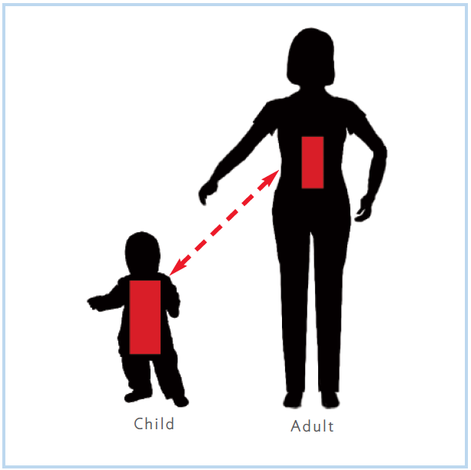
Exposure
Children exposed to the same dose of environmental toxins and/or chemicals have proportionately much greater exposure compared to adults

Slide 25
Hazards of Cleaners, Sanitizers and Disinfectants
Most cleaning, sanitizing or disinfection products sold are not safe, even though they are available at most stores.
Only the chemicals that kill bacteria, viruses, or mold (disinfectants) have to be labeled.
Manufacturers are not required to list all the ingredients on the label.
Many cleaning and sanitizing chemicals can cause health problems in children and staff.

Slide 26
Why is it Important to Clean and Sanitize in ECE Centers?
Research shows that when schools improve their physical environments children are able to feel better about themselves and their school.
Studies also show that these children learn more as a result!
Getting rid of clutter helps makes it easier to focus on tasks. It also gets rid of hiding places for pests like rodents and cockroaches

Slide 27
Why is it Important to Clean and Sanitize in ECE Centers?
The presence of moisture, standing water and mold can cause respiratory problems like asthma, and allergies.
Infectious illnesses like colds, flu and asthma are the most common reason children are absent from ECE. We can help to prevent this.

Slide 28
Health hazards of Cleaners, Sanitizers and Disinfectants Key Points:
The words “natural,” “nontoxic,” and “green” that appear on product labels are unregulated by the government.
Researchers have found that products labeled “green” often have as many toxic chemicals as conventional cleaning products.
Researchers have found that products labeled “green” often have as many toxic chemicals as conventional cleaning products.
These gaps in ingredient information on product labels make it difficult for the consumer to make wise choices when purchasing cleaning products.

Slide 29
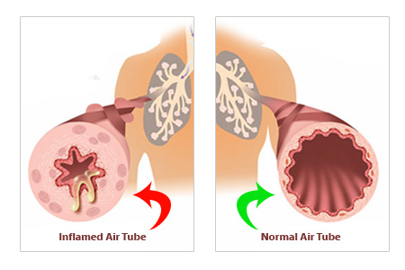
Asthma and Asthmagens
  Many cleaning, sanitizing, and disinfecting products can irritate the lungs, and trigger or even cause asthma.
  Asthma is a chronic inflammatory disorder of the airways in the lungs that results in:
    Wheezing
    Coughing
    Chest tightness
    Trouble breathing

Slide 30
Asthma and Asthmagens
Asthma Triggers:
Once a person has asthma, exposure to these “triggers”
can cause an episode of asthma.
These triggers include:
Household Dust and dust mites
Pets
Cockroaches
Mold
Cigarettes
Cleaning Products

Slide 31

Endocrine Disrupting Chemicals (EDCs)
  Endocrine Disruptors are chemicals that interrupt or imitate natural hormonal messages.
  Since hormones work at very small doses, endocrine disrupting chemicals can also affect health in very small amounts.
  Endocrine disruptors may cause:
  -reduced fertility in women and men
  -early puberty in girls
  -increases in cancers of the breast, ovaries, and prostate.
Very small doses of EDC’s can harm people in different ways, essentially tricking the body into responding to chemicals as hormones during key stages of development.

Slide 32

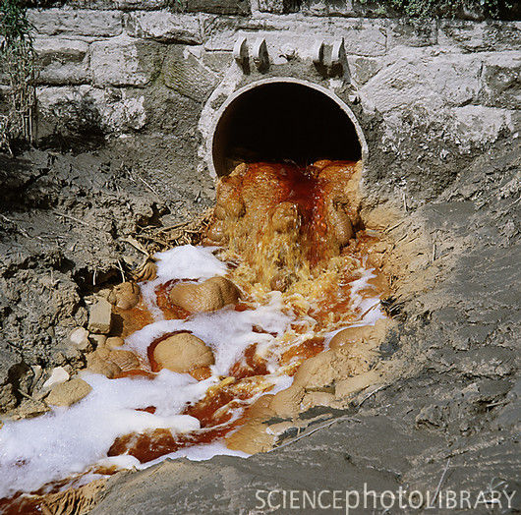
What About the Environment?
Many cleaners, sanitizers, disinfectants, and fragrances (even those marketed as ‘green’) pollute the air, water, and soil.
A clean ECE Center Damage to the Environment
May cause

Slide 33
Triclosan
Many cleaning, sanitizing and Disinfecting products contain the germ-killing chemicals triclosan and its relative, triclocarbon.
These active ingredients act to slow or stop the growth of bacteria, fungi, and mildew.
They are found in antibacterial soaps, deodorants, sponges and household cleaners and disinfectants.
Triclosan ends up in our drains, sewage systems and, eventually, our waterways and agricultural fields. Over 400,000 pounds, to be exact.
Much of the Triclosan we flush, wash away, and dispose of in other ways ends up in the soil, where it is absorbed by growing fruits and vegetables.
Notes:
The transport of triclosan to wastewater treatment plants occurs when people:
Wash hands with antibacterial soap
Hand wash dishes with antibacterial soap
Clean with antibacterial products
Use antibacterial products in a dishwasher

Slide 34
Fragrances
Fragrances are found in most cleaning, sanitizing and disinfecting products, and contain chemicals called volatile organic compounds (VOC’s).
VOC’s impact both indoor and outdoor air quality, as well as the water supply.
Like Triclosan, VOC’s are not filtered out by water treatment, which results in contamination of our lakes, rivers and bays.
In fact, nearly all shellfish and fish in the United States now have measurable levels of fragrances in their tissues!
Notes:
The transport of triclosan to wastewater treatment plants occurs when people:
Wash hands with antibacterial soap
Hand wash dishes with antibacterial soap
Clean with antibacterial products
Use antibacterial products in a dishwasher

Slide 35
Fragrances and Human Health
The Facts
Fragranced products contain additional chemicals that can cause health problems. These problems include:
-Lung irritation, including asthma
- Skin irritation
-Eye irritation
Even ‘unscented’ or ‘fragrance-free’ products may actually contain fragrances which are added to mask the smell of the chemicals in the product.
The chemicals contained in these fragranced products enter the body in many ways. They are:
  -Absorbed through the skin
  -Swallowed
    -Inhaled into the lungs
    Just because a cleaning product smells good does not mean it is healthy or does its job.

Slide 36
Fragrances and Human Health
What You Can Do About It:
Consider using fragrance-free, non-chlorine bleaches containing hydrogen peroxide instead of those that are scented.
Choose unscented cleaning products that have been certified by third party groups such as Green Seal, EcoLogo or Design for the Environment.
  Avoid scented candles, air fresheners, and other scented items.
  If a scented item is used, open windows and doors (if weather permits). This allows the smell (fragrance) to escape, thereby lowering the risk of exposure to the chemicals in fragrances.

Slide 37
What is the Difference Between Cleaning, Sanitizing and Disinfecting?
Before choosing any type of cleaning or antimicrobial product, you will first need to decide whether the surface needs to be:
Cleaned
Ssanitized
or
Disinfected

Slide 38
What is the Difference Between Cleaning, Sanitizing and Disinfecting?
It doesn’t make sense to disinfect something that only needs to be cleaned because the products used to disinfect are more toxic and/or more expensive than products used to just clean.
Overusing antimicrobial products may also lead to the spread of "super bugs." Superbugs are germs that are resistant to disinfectants and/or antibiotics.

Slide 39
Cleaning
removes germs, dirt, and impurities
from surfaces or objects.
uses soap or detergent and water to physically remove germs from surfaces. This process does not necessarily kill germs.
removes molds and allergens that can trigger asthma symptoms.
can remove as much as 99% of germs when microfiber cleaning tools are used.
Notes:
By removing germs and washing them down the drain, cleaning lowers their numbers and the risk of spreading infection.

Slide 40
Sanitizing
Regulated as Pesticide
Lowers the number of germs on surfaces or objects to a safe level
For hard, non-food surfaces the level
should be reduced by at least 99.9%.
For food surfaces this level should be a 99.999% reduction in microorganisms within 30 seconds.
Sanitizing products should state on their label the surfaces they are intended to be used on.
Sanitizers are used on food preparation and contact surfaces, and mouthed toys and pacifiers.
Notes:
See state child care regulations and the Caring for Our Children: National Health and Safety Performance Standards, Routine Schedule for Cleaning, Sanitizing and Disinfecting (Appendix 5) for guidelines on when and where to clean, sanitize and disinfect.

Slide 41
Disinfecting
Kills 99.999% of germs on surfaces or objects.
does not necessarily clean dirty surfaces or remove germs.
kills germs on contact if the disinfectant sits wet, or “dwells,” on the surface long enough.
For use on:
-changing tables
-bathroom sinks and toilets.
-High touch areas which are at high- risk for collecting lots of germs, such as doorknobs and drinking fountains.
A disinfectant must stay on the surface for at least the recommended dwell time or it will not ‘kill’ all of the germs on that area
Notes:
Because disinfectants are pesticides designed to kill or inactivate germs, you should think carefully about when and where you use them. The overuse and misuse of these products is a growing public health and environmental concern. Studies have found that the use of some disinfectant products is creating microbes that can mutate into forms that are resistant to particular disinfectants or that become superbugs

Slide 42



Identifying Safer Products
Institutional vs Retail:
-An ECE facility can be cleaned using just a few products.
-These products can be purchased as an institutional cleaning product or a retail cleaning product.
Third-party certified products:
-Green Seal
-EcoLogo
-Design for the Environment
-Others
Notes:
42
Examples include:
DfE – Clorox Green Works, Method
Green Seal – Simple Green Cleaning Building (not their regular line)
EcoLogo -

Slide 43
Institutional Products are:
purchased from a cleaning products distributor.
often not available in retail stores.
available as a concentrate.
accompanied by safety data sheets (SDS)*.
generally less expensive.
It is easier to find institutional products that are certified as safer by a third-party ( Green Seal, EcoLogo or Design for the Environment)

Slide 44
Retail Products:
are purchased at a retail store like a grocery store.
are available in ready-to-use containers.
are less likely to be certified as safer by a third-party (Green Seal, EcoLogo or Design for the Environment).
do not come with OSHA-required Safety Data Sheets.
Retail Products are often more expensive and not labeled as completely as institutional products

Slide 45
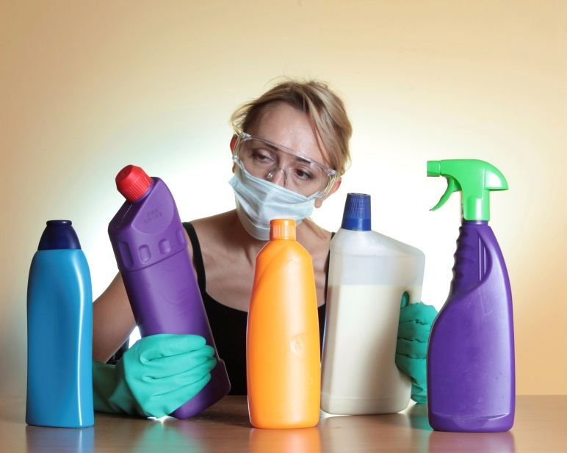
Ingredients To Avoid:
2-butoxyethanol (or ethylene glycol monobutyl ether) and other glycol ethers
Alkylphenol ethoxylates (some common ones are: nonylphenol and octylphenol ethoxylates, or octoxynols)
Bisphenol A
Dyes (may be listed as FD&C or D&C):
Ethanolamines
monoethanolamine [MEA]
diethanolamine [DEA]
triethanolamine [TEA])
Fragrances
Parabens and Phthalates
Pine or citrus oil
Quaternary ammonium compounds: (look out for these: alkyl dimethyl benzyl ammonium chloride (ADBAC), benzalkonium chloride, and didecyl dimethyl benzyl ammonium chloride)
Notes:
Distributors will provide the dilution stations and labeled bottles for the diluted products. It’s important when using a concentrate to dilute the product as recommended on the label.
must have MSDS on site to satisfy Occupational Safety and Health Administration (OSHA) rules.**

Slide 46
Choosing Safer Sanitizers
Caring for Our Children: National Health and Safety Performance Standards recommends sanitizing for:
-Toys
-Thermometers
-Pacifiers
-Teething toys
-Eating utensils
-Tables and high chair trays
-Food preparation areas
-Mixed use tables
-Computer keyboards.
When choosing a sanitizer look for the following:
0 rating on the Hazardous Materials Identification System health rating scale.
The signal word Warning rather than Danger on the label.
EPA registration number (verifies that that the product is registered by them to kill the germs claimed on the label).
Approval for food contact surfaces.
Short dwell time (the time the sanitizer must be left wet on the surface and in contact with the germs to kill them).
Notes:
Mention the benefits of accelerated hydrogen peroxide.

Slide 47
Choosing Safer Disinfectants
There are many types of Disinfectants and not all disinfectants kill germs.
Some require a shorter process of disinfecting an area.
Make sure you identify “one-step” disinfectant-cleaner versus a disinfectant.
When Choosing a Disinfectant, Look for the Following:
0 rating on the Hazardous Materials Identification System health rating scale
The signal word Caution, rather than Danger, Poison or Warning on the product label
EPA registration number
Hospital-grade classification (this is a requirement of child care licensing agencies in most states)
Short dwell time or the time the sanitizer must be left wet on the surface
Notes:
All disinfectants are required to have an EPA Registration number.
Is it safe for the use intended?
Will it damage the surfaces cleaned with it?
What germs does it kill?
Not all disinfectants kill all germs
A “hospital grade” disinfectant sounds like it kills all sorts of germs, but it is only required to kill three target organisms: Salmonella choleraesuis , Staphylococcus aureus , and Pseudomonas aeruginosa. Many identify other germs that they kill as well, but you have to check.
What is the dilution ratio of the product? (How do I mix it correctly?)
Is it a “one-step” disinfectant-cleaner or a disinfectant?
Is it effective in hard (tap) water or do I need to mix it with distilled water?
Purchasers for state and institutional cleaning programs (hospitals, universities, etc.) have identified the following as a safer active ingredient for disinfectants:
Accelerated hydrogen peroxide

Slide 48
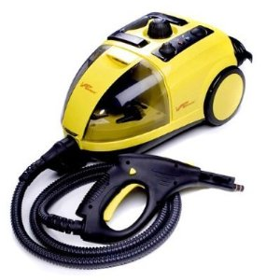
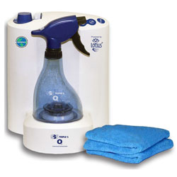
Devices
  Dry steam vapor technology:
  Very effective for cleaning and rapid disinfecting
  Approved for most surfaces, including
  food contact surfaces.
  Unfortunately, still very expensive.
  Liquefied ozone:
  recognized by the US Food and Drug
  Administration (FDA) as a commercial disinfectant
  Used for both food contact and non-food
  contact surfaces.
  Has been awarded the Generally Recognized
  as Safe (GRAS) classification by the FDA.
  There is no residue from the Liquefied Ozone
  device so no rinsing is required

Slide 49
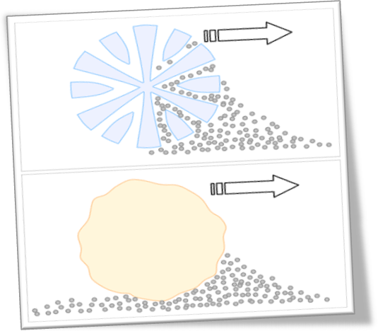
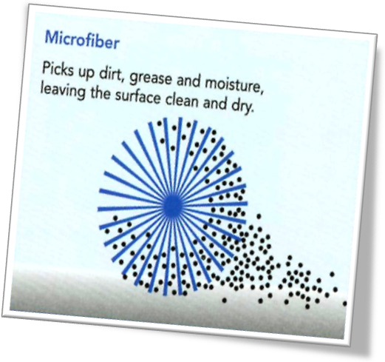
Microfiber
GREAT alternative to normal rags or paper towels!
Works very well for removing organic matter (dirt, oils, grease) as well as germs from surfaces.
As a result of its unique design, microfiber cloth has the same surface area as a cotton cloth four times as large!
Microfiber is also very absorbent; It can absorb 7 times it’s weight in water.
Microfiber products are positively charged, meaning they attract negatively charged dirt, germs and grease, and they offer the ability to clean surfaces without chemicals.
Notes:
Refer to room-by-room guidelines for cleaning, sanitizing, and disinfecting.

Slide 50
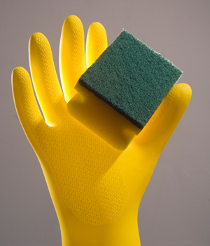
Sponges
Avoid using sponges in your kitchen. Use microfiber instead.
Sponges are perfect breeding grounds for germs. They are dirty and wet, providing food and drink for germs to grow.
If you want to use a sponge, microwave it for one minute every day (make sure your sponge is wet and doesn’t contain any metal), or put it in the dishwasher every time you run it.
Notes:
Refer to room-by-room guidelines for cleaning, sanitizing, and disinfecting.

Slide 51
The Most Effective Ways of Reducing the Spread of Infectious Disease are Found in Our Personal Behaviors.
Research has shown that caregiver hands in ECE harbor more germs than almost any other surface. Caregivers change diapers, assist children with toileting, wipe noses, hold hands, handle mouthed toys and more
Hand washing is the single most important thing you can do to reduce the spread of infectious disease in ECE as well as at home.
Although microbes are everywhere, most are harmless and many are helpful. The goal of an infection-control program is to reduce the spread of infectious disease by reducing contact with disease causing germs or microbes.
Notes:
All disinfectants are required to have an EPA Registration number.
Is it safe for the use intended?
Will it damage the surfaces cleaned with it?
What germs does it kill?
Not all disinfectants kill all germs
A “hospital grade” disinfectant sounds like it kills all sorts of germs, but it is only required to kill three target organisms: Salmonella choleraesuis , Staphylococcus aureus , and Pseudomonas aeruginosa. Many identify other germs that they kill as well, but you have to check.
What is the dilution ratio of the product? (How do I mix it correctly?)
Is it a “one-step” disinfectant-cleaner or a disinfectant?
Is it effective in hard (tap) water or do I need to mix it with distilled water?
Purchasers for state and institutional cleaning programs (hospitals, universities, etc.) have identified the following as a safer active ingredient for disinfectants:
Accelerated hydrogen peroxide

Slide 52


Behavioral Strategies That can Reduce Infectious Disease Spread
1.) Cough and sneeze etiquette:
-Cover your nose and mouth with a tissue when you cough or sneeze, then wash your hands
-If a tissue is not available, cover your mouth and nose with your sleeve, not your hand.
2.) Isolation/social distancing:
Stay home if you are sick. Don’t risk passing your germs on to others at your program.
-Encourage coughing or sneezing children/staff to leave a 3-6 foot buffer between themselves and others.
Notes:
All disinfectants are required to have an EPA Registration number.
Is it safe for the use intended?
Will it damage the surfaces cleaned with it?
What germs does it kill?
Not all disinfectants kill all germs
A “hospital grade” disinfectant sounds like it kills all sorts of germs, but it is only required to kill three target organisms: Salmonella choleraesuis , Staphylococcus aureus , and Pseudomonas aeruginosa. Many identify other germs that they kill as well, but you have to check.
What is the dilution ratio of the product? (How do I mix it correctly?)
Is it a “one-step” disinfectant-cleaner or a disinfectant?
Is it effective in hard (tap) water or do I need to mix it with distilled water?
Purchasers for state and institutional cleaning programs (hospitals, universities, etc.) have identified the following as a safer active ingredient for disinfectants:
Accelerated hydrogen peroxide

Slide 53
Recommendations
Sanitizers
Food contact surface sanitizers:
SanidateRTU(H202+PAA)
Seventh Generation RTU (Thymol)
Limited: Pure Hard Surface RTU (Silver + Citric Acid)
Non food contact surface sanitizers:
Alpha HP @ 1:128 dilution (Accelerated H202)
H2Orange118@1:12dilution(H202)
Windex Multi-Surface Antibacterial RTU; 10 second dwell (Lactic acid)

Slide 54
Product Recommendations
Disinfectants
Ready to use (RTU)
Clorox Green Works (1.4% H202) 30 sec dwell time
OxivirTb(0.5%AHP) 1 min dwell time
Clean-Cide (0.6% Citric acid) 10 min dwell time
Quantum Tb (0.138% Caprylic acid) 10 min dwell time
Limited:
Pure Hard Surface (Silver + Citric Acid) 1 min dwell time
Concentrate
5 min: Oxivir Five 16 (4.25% AHP; 1:16)

Slide 55
Product Recommendations
Disinfectants
Ready-to-use (contd.)
Oxivir Five 16 @ 1:16 dilution (Accelerated H202)
Clorox Green Works RTU(H202)
Oxivir Tb RTU (Accelerated H202)
Limited: Pure Hard Surface RTU (Silver + Citric Acid)
Concentrate
5 min: Oxivir Five 16 (4.25% AHP; 1:16)

Slide 56
Resources
For more information visit these websites:
Design for the Environment – list of products available at: http://www.epa.gov/dfe/.
EcoLogo - list of products available at: http://www.ecologo.org/en/certifiedgreenproducts/?category_id=21#21.
Environmental Working Group – information on what’s in specific cleaning products. Available at: http://www.ewg.org/cleaners/hallofshame/?utm_source=201208cleanershosfull&utm_medium=email&utm_content=first-link&utm_campaign=toxics.

Slide 57
Resources
Grassroots Environmental Education - The ChildSafe Product List. Available at: http://www.grassrootsinfo.org/cslist10-11.html.
Green Guard Environmental Institute – Children and Schools certified cleaning products. Available at: http://www.greenguard.org/en/SearchResults.aspx?CategoryID=30&pageNumber=1.
Green Seal - list of products available at: http://www.greenseal.org/FindGreenSealProductsAndServices.aspx.
Women’s Voices for the Earth – Information on what’s in specific cleaning products and recipes for making your own less-toxic cleaner. Available at: http://www.womensvoices.org/protect-your-health/cleaning-products/

Slide 58
Questions?
Victoria Leonard, PhD
UCSF Institute for Health and Aging
Victoria.Leonard@UCSF.edu
Asa Bradman, PhD
(Please insert your title and contact)
Abradman@Berkeley.edu
Jesse Berns
MPH(C) Epidemiology, U.C. Berkeley
Research Assistant, UCSF Institute for Health and Aging
Jessberns1@Berkeley.edu

