Slide 1

Fill in as you like

Slide 2
Acknowledgement and COI
This presentation was supported by the American Academy of Pediatrics (AAP) and funded (in part) by a cooperative agreement with the Centers for Disease Control and Prevention/Agency for Toxic Substances and Disease Registry (CDC/ATSDR). The U.S. Environmental Protection Agency (EPA) supports the PEHSUs by providing partial funding to CDC/ATSDR through an Inter-Agency Agreement.
The findings and conclusions in this presentation have not been formally disseminated by CDC/ATSDR or EPA and should not be construed to represent any agency determination or policy. Use of trade names that may be mentioned is for identification only and does not imply endorsement by the CDC/ATSDR or EPA.
I HAVE NO CONFLICTS OF INTEREST TO DECLARE.

Slide 3
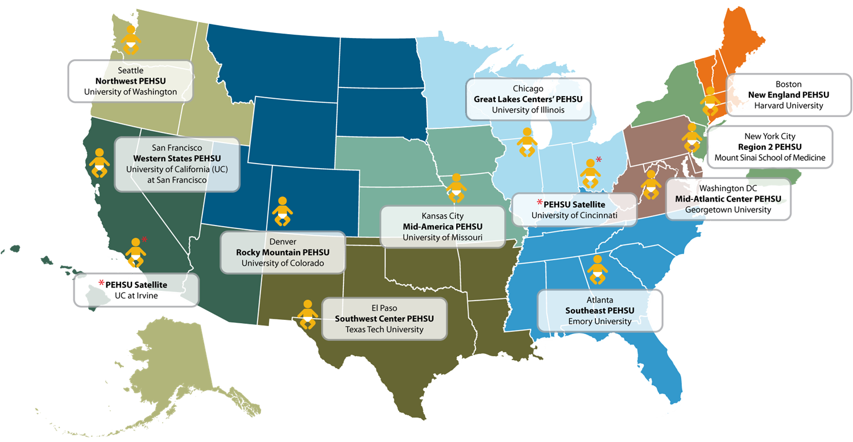
Pediatric Environmental Health Specialty Units
(PEHSU)
www.pehsu.net
Notes:
What is a PEHSU??? PEHSUs were created in 1998 to provide expertise on issues related to pediatric and reproductive environmental health.
Their vision is a healthier world for children and pregnant and lactating women through expanded educational outreach, consultative, and referral services.
To Improve the ability for PEHSUs to be able to respond to questions from parents and clinicians about environmental chemicals associated with childhood cancer risk, the pediatric oncology clinician education supplement (POCES) project was developed. The POCES project It is supported by the AAP with funding from the CDC, specifically from new legislation called Trevor’s Law, which aims to disperse information on what we know regarding environmental contributors to childhood cancer.
Champions were designated for each PEHSU region.
PEHSU Champions improve the ability for PEHSUs to be able to respond to questions from parents, and their communities in general, about environmental chemicals associated with childhood cancer risk;
Champions understand the approaches taken to identify cancer clusters (and limitations in identifying a causative agent in a true cancer cluster);
They can provide appropriate risk reduction guidance to families concerned about potential exposures.

Slide 4
A Mother’s Lament
“When our daughter was diagnosed with Wilms’ Tumor, a kidney cancer, I wanted to know why.” said journalist Alexandra Zissu.
“Could there be an environmental link? Our beloved oncologist’s work is to cure, not to sleuth. But as an environmental health journalist, it didn’t sit well with me that there was no one on staff at our hospital – one of the top cancer facilities in the country – who asked questions about home environment at the intake or gave us any specific environmental advice during or after active treatment.”
“I was left to do my own research. Exhausted patients and caregivers rely on our doctors, nurses, child life specialists – and more – to guide us through this unique hell. I would vastly have preferred to collaborate on her care – as we were able to in every other realm – rather than arrive at my own environmental health conclusions.”

Slide 5

Learning Objectives
Explain the overall trend in pediatric cancer incidence compared to mortality over time.
Explain the ‘two-hit’ theory of childhood cancer causation.
List at least 2 reasons why children are more vulnerable to environmental toxins.
Describe three mechanisms by which environmental chemicals can induce cancer.
Identify 2 ‘protective’ factors against the development of childhood cancer.
Define the concepts of the ‘IARC’ and the ‘precautionary principle.’
Describe 3 prevention strategies in counseling families about environmental childhood cancer hazards.

Slide 6
Outline
Incidence, Trends, and Health Disparities
Survey: Knowledge Gaps
Cancer Research Design Limitations
Children’s Vulnerability
Biology and Mechanisms
Immune Regulation and Infection
Diet
Environmental Chemicals and Children’s Cancer
Taking an Environmental History
Prevention: Parent’s needs and questions
Resources

Slide 7
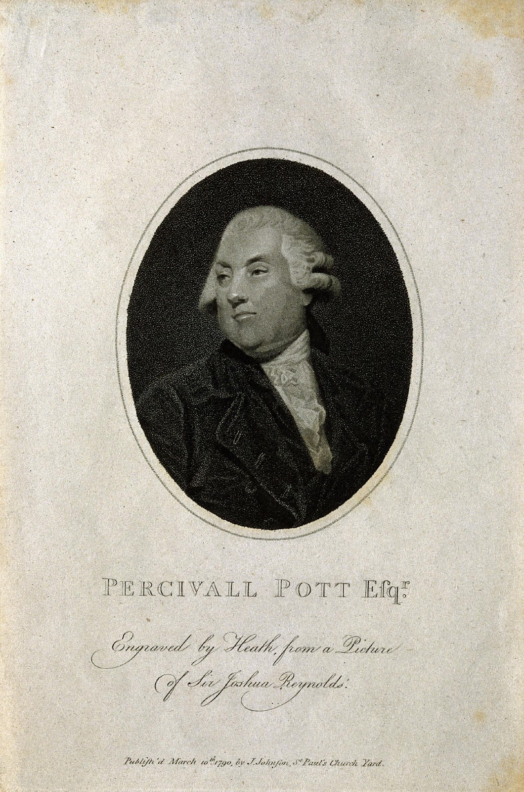
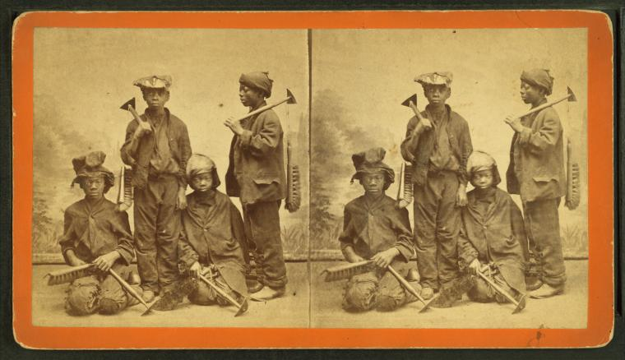
Sir Percivall Pott
1714-1788 ‘soot wort’
“If there be any chance of putting a stop to, or preventing this mischief, it must be the immediate removal of the part affected; I mean that part of the scrotum where the sore is…”
1775
Photos in public domain, curated from https://commons.wikimedia.org
BROWN JR, THORNTON JL. Percivall Pott (1714-1788) and chimney sweepers' cancer of the scrotum. Br J Ind Med. 1957. PMID: 13396156.
Notes:
Environmental causes of childhood cancer is not a new topic.
Sir Percivall Pott, considered the ‘father’ of occupational medicine, was the first to ascribe a childhood cancer, in this case scrotal cancer, to an environmental cause – that is, the soot and chemical deposits left in dirty chimneys that the children were used to clean them as ‘sweepers’. The Chimney Sweepers Act 1788 (8 yr) of 1834 (14 yr) and of 1840 (21 yr) and of 1875 (enforced) effectively put an end to the employing of children for this purpose in England.

Slide 8
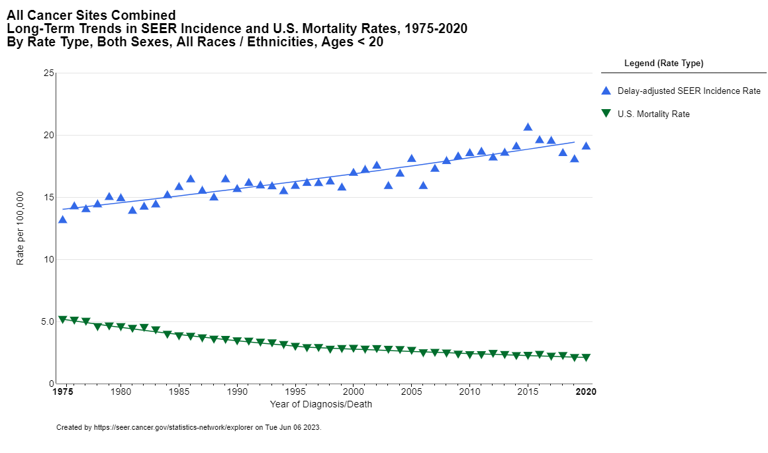


Overall Cancer Incidence and Mortality
Trends in Pediatrics
2nd cause of death overall
1st cause of disease-related death
1/8 children will NOT survive
60% of survivors have long-term serious health complications
Financial toxicity for families and Financial impact on society
Similar trends in most industrialized countries (Steliarova-Foucher et al., Lancet Oncol 2018)
Incidence: Annual percent change: ↑ 0.7
Mortality: Annual percent change: ↓ 2.7
Notes:
Cancer is among the leading causes of serious illness and death in children and teens in the US.
Survival rates for childhood cancers are much higher than in the past due to major advances in cancer treatment (green), but the RATE of childhood cancers has been INCREASING over the past few decades.
Pediatric cancer is rare (reference: National Cancer Institute, 2019)
Children (0-14yo): ~11,050 new cases in 2020.
Adolescents and young adults (15-39yo): ~89,500 new cases in 2020.
Increased incidence over time (SEER data)
The incidence of many cancers in children and adolescents is increasing in most industrialized countries.
What is playing a role?
The environment: must be a major contributing factor to these upward trends, alone or in combination with genetic susceptibilities.
Early-life exposures: pre and postnatally must be considered in etiologic studies .

Slide 9
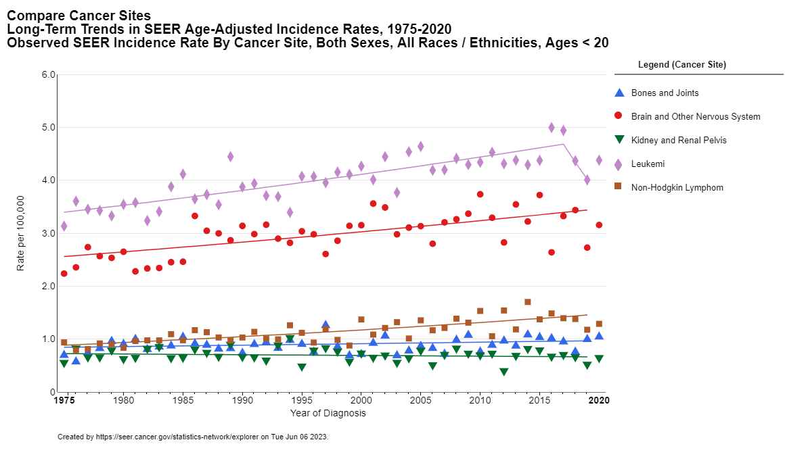
Overall Incidence by Cancer Site in Pediatrics in the United States
Annual percent change 19975-2020:
Cancer site | Trend | Rate | Significant
Leukemia | ↑ | 0.8 | Significant
Brain and other CNS | ↑ | 0.7 | Significant
NHL | ↑ | 1.1 | Significant
Bones and Joints | ↑ | 0.3 | Not significant
Kidney and Renal | ↓ | 0.2 | Not significant
Notes:
Recent trends in overall incidence of childhood cancer by the site of cancer. Purple diamonds indicate that the overall trend is UPWARD, both for childhood leukemia and brain and other CNS cancers, non-Hodgkin’s lymphoma, and bone and joint cancers, while it is a downward, although insignificant, trend in kidney and renal cancer incidence.

Slide 10
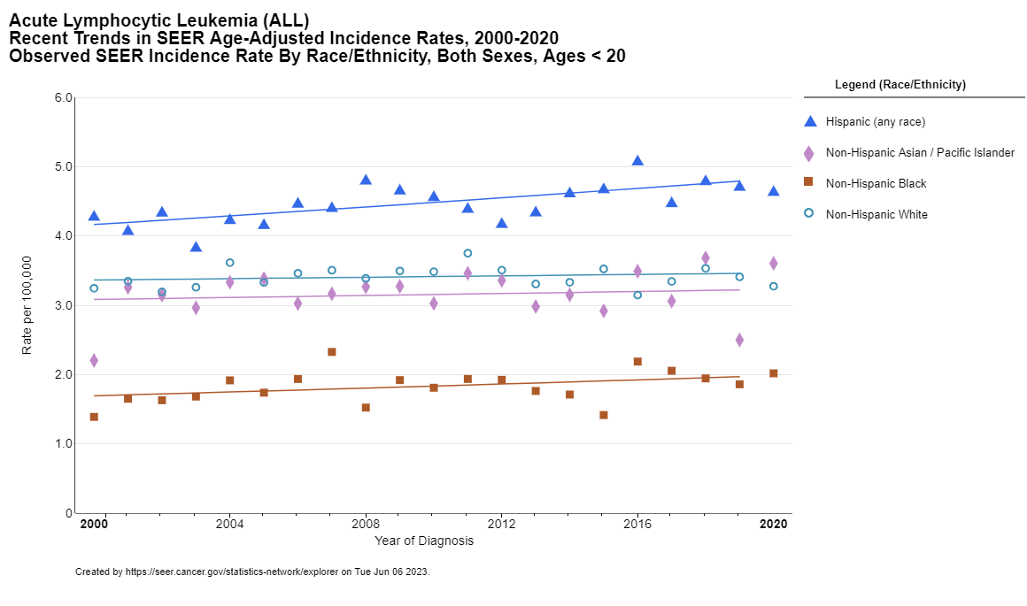
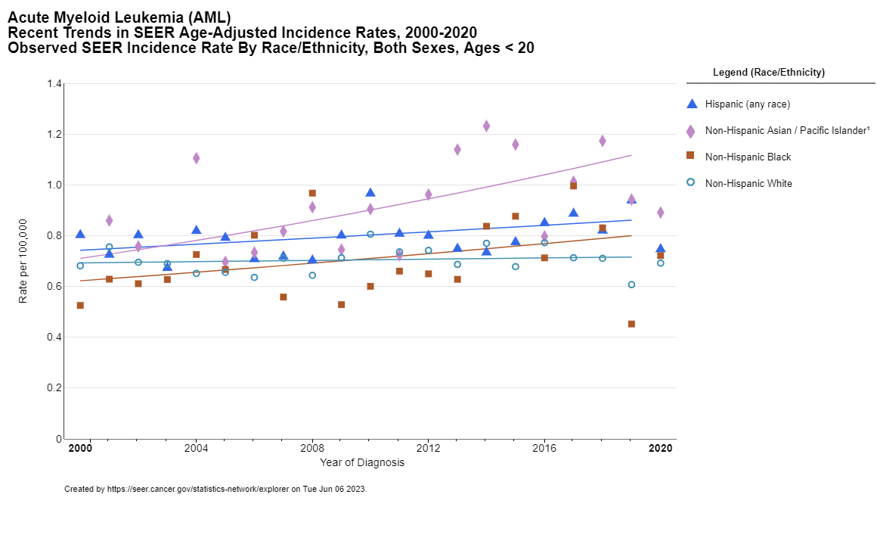
Racial/Ethnic Disparity in
Pediatric Cancer Survival: Leukemia
ALL
AML
Hispanic: Annual percent change: ↑ 0.7
Non-Hispanic Asian/PI: Annual percent change: ↑ 2.4

Slide 11
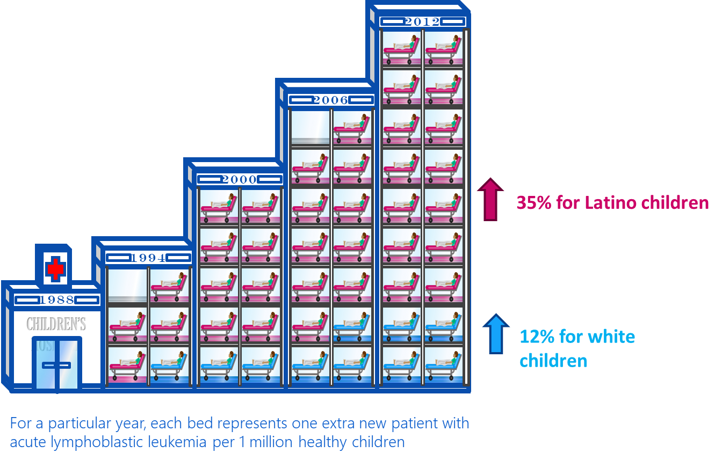
Racial/Ethnic Disparity in Pediatric Cancer Survival:
Acute Lymphoblastic Leukemia
Hispanic: Annual percent change: ↑ 0.7
Notes:
Looking further at the hispanic population and the rise in incidence of ALL:
For a particular year, each bed represents one extra new patient with acute lymphoblastic leukemia per 1 million healthy children.
Cases of childhood leukemia (CL) have increased in the past 30 years. Increases in Latino children are even higher.
The exact cause of many childhood cancers is unknown. There is evidence linking exposures to environmental hazards, including tobacco smoke, pesticides, and solvents, to certain childhood cancers.
Unfortunately, pediatric hematology/oncology (PHO) providers do not receive training on this, and a knowledge gap exists.

Slide 12
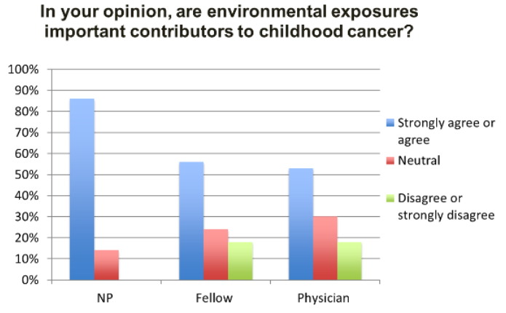
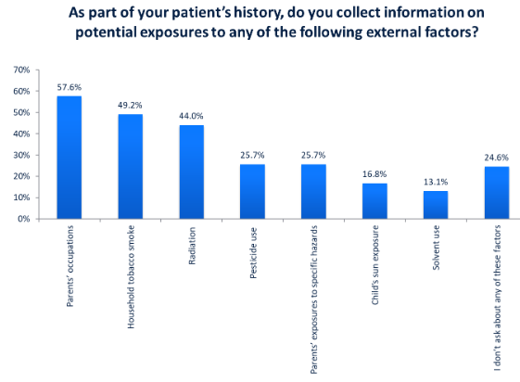
Knowledge Gap
Only 6% reported training on taking an environmental history
Adapted from: Zachek CM, et al. Children's Cancer and Environmental Exposures: Professional Attitudes and Practices. J Pediatr Hematol Oncol. 2015. PMID: 26334434.
Notes:
From this 2015 survey of PHO providers, we know that the majority do believe that the environment matters (with nurse practitioners showing the strongest agreement).
We also know that a sizeable number of clinicians (as evidenced by the red and green lines in the bar graph on the left) are not yet aware of or convinced of its importance.
In the same study, only 6% reported receiving any training on environmental health history taking. Of those that did, most asked about parental occupation and household tobacco smoke. A small number asked about specific exposures (such as radiation, pesticides and specific solvents). Over a quarter did not ask about any specific exposure.

Slide 13
Knowledge Gap – Survey Results
Which do you think are likely causes of leukemia in children?
Genetics (92%)
Health Status (25%)
Environment (78%)
None of Above (7%)
Are environmental exposures important contributors to childhood cancer?
Strongly Agree/Agree (61%)
Disagree/Strongly Disagree (15%)
How often, if ever, have you suspected the cancer was related to something in the patient’s environment?
Frequently or Occasionally (27%)
Rarely (50%)
Never (23%)
How often have you received questions from patients or parents about potential workplace or environmental exposures as possible causes of disease?
Frequently or Occasionally (88%)
Adapted from: Zachek CM, et al. Children's Cancer and Environmental Exposures: Professional Attitudes and Practices. J Pediatr Hematol Oncol. 2015. PMID: 26334434.
Notes:
There is a low level of knowledge in the area but a high level of interest to learn more.
88% of providers report getting questions from families (and HALF were uncomfortable discussing with families).
92% said they would find it helpful to have information about environmental exposures.
We need to know how to consistently and accurately answer these questions.
Clinicians should understand the potential risks, assess individual risks, and help to inform and guide families to understand how they can make better choices.

Slide 14
Methodological Limitations:
Childhood Cancer Epidemiological Studies
Complexity and multi-factorial causation
Case-Control or Observational Studies
  Careful control for bias and confounders is important
  Pooled analyses from well run case control studies add strength to the findings
Prospective Cohort Studies
  Impractical – cancer is a rare disease
  Costly
Bradford-Hill Criteria
  Biologically plausible
  Consistency
  Reproducibility
Items not yet addressed/future research:
    Cumulative impact of multiple exposures, other childhood cancers, and disease
    Emerging chemicals
    Contribution of genetic susceptibility – the gene/environment interaction. Hard to do studies because of level of uncertainty of exposure and small numbers.
    Environmental impact in cancer survivors
Notes:
Cancer is a rare disease. It is complex and heterogenous, and the incidence is likely multi-factorial.
It is important to be creative and increase the numbers of kids studied by working with cancer registries, linkage when possible, and build international collaboration.
Biologic specimens for biomarkers studies are sparse. Most childhood (and AYA) cancer have a fetal origin so there is a need for prenatal or neonatal specimens.
Two ways to study epidemiology: Start with those that have not gotten disease yet and wait years vs. Start with cases and controls (which is the most efficient).
How do we tackle the retrospective nature of these studies.
Multiple approaches:
Biological sampling, home sampling, geocoded addresses, parenteral (usually maternal) interviews.
Can you determine causality based on case-control studies? Smoking and lung cancer study was designed with case-control study. There are statistical ways to help strengthen. Biomarker studies help validate.
There are limitations (as with any type of study), but epidemiologists have been innovative and produced creative ways to get the data.
Many of these exposures and cancers (mostly leukemia) have strong data. Almost all the data we are talking about are from case-control studies.
Prospective cohort studies (traditionally characterized as the best way to determine causality) are often not designed for the exposure we are looking for in these cases and inferences are made when compared. A case control study that is designed to look at a specific exposure is often times stronger, especially when pooled with other similar studies.
This IS evidence based.
As an example, the childhood cancer and leukemia international consortium (or CLIC) was developed to address some of these limitations. They get numbers and a deeper dive that address different issues across time, location, and studies with similar findings. Data from these studies are pooled and harmonized and very valuable.

Slide 15


Children’s Vulnerability
Immature immune system
Immature, thin skin
Immature lungs (until 8yo)
Immature detox – liver, kidneys, lungs
Porous BBB until 4yo; sensitive forming brain tissue
Breathing zone – close to ground
Rely on others for safety, protection, or escape
Mobile – crawl, cruise, walk
Curious
Pica and oral exploration
Mimicry
Poor cognitive discrimination
Smaller size and weight; longer lifespan
Nutritional deficiencies
Breast feeding
Why should these vulnerabilities matter to a pediatric oncologist?
Notes:
Why are children at greater risk?
pregnancy, childhood, and adolescence are vulnerable periods because of rapid growth and development.
Exposure to environmental hazards during these periods results in higher risk of health effects.
Children may be exposed to environmental hazards anywhere – indoors (at home, school, childcare, etc) and outdoors. Children have special vulnerability to both indoor and outdoor air pollutants by virtue of their Anatomy, Physiology, and Other Environmental Factors. They are closer to the ground, where dust and chemicals can build up. Their lower breathing zone exposes them to higher concentrations of some fumes and gases with increased vapor pressure and density. They put their hands in their mouth, exposing them to further.
The negative health impacts of early exposures to environmental hazards can continue throughout life.
What about the relation of these to CHILDHOOD CANCER? By the time they see an oncologist, the patients have already been exposed. Critics may say, “what is my role?” It is imperative to remember:
Children will be more vulnerable to the environment during and after treatment.
Siblings are also exposed to a similar environment and their potential risk should be considered as well.
There are personalized risk reductions and mitigations that can be done to protect children moving forward, after diagnosis.

Slide 16
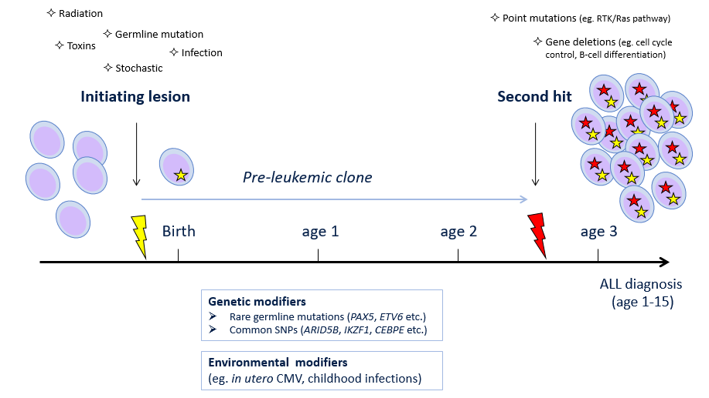
Windows of Susceptibility
Figure modeled after Greaves M. Infection, immune responses and the aetiology of childhood leukaemia. Nat Rev Cancer. 2006 Mar;6(3):193-203. PMID: 16467884.
Notes:
Acute lymphoblastic leukemia (ALL), like cancer in general, probably arises from interactions between exogenous or endogenous exposures, genetic (inherited) susceptibility, and chance. The challenge is to identify the relevant exposures and inherited genetic variants and decipher how and when these factors contribute to the multistep natural history of ALL from initiation (usually in utero) through to overt disease.
2-hit hypothesis:
Leukemia is a disease with prenatal and postnatal events.
In terms of the “natural history” of ALL, some children are born with that first hit.
We know that not all preleukemic clones become overt leukemia…suggesting that interventions might be possible to prevent transformation.
The question then becomes, can we prevent the second hit?

Slide 17
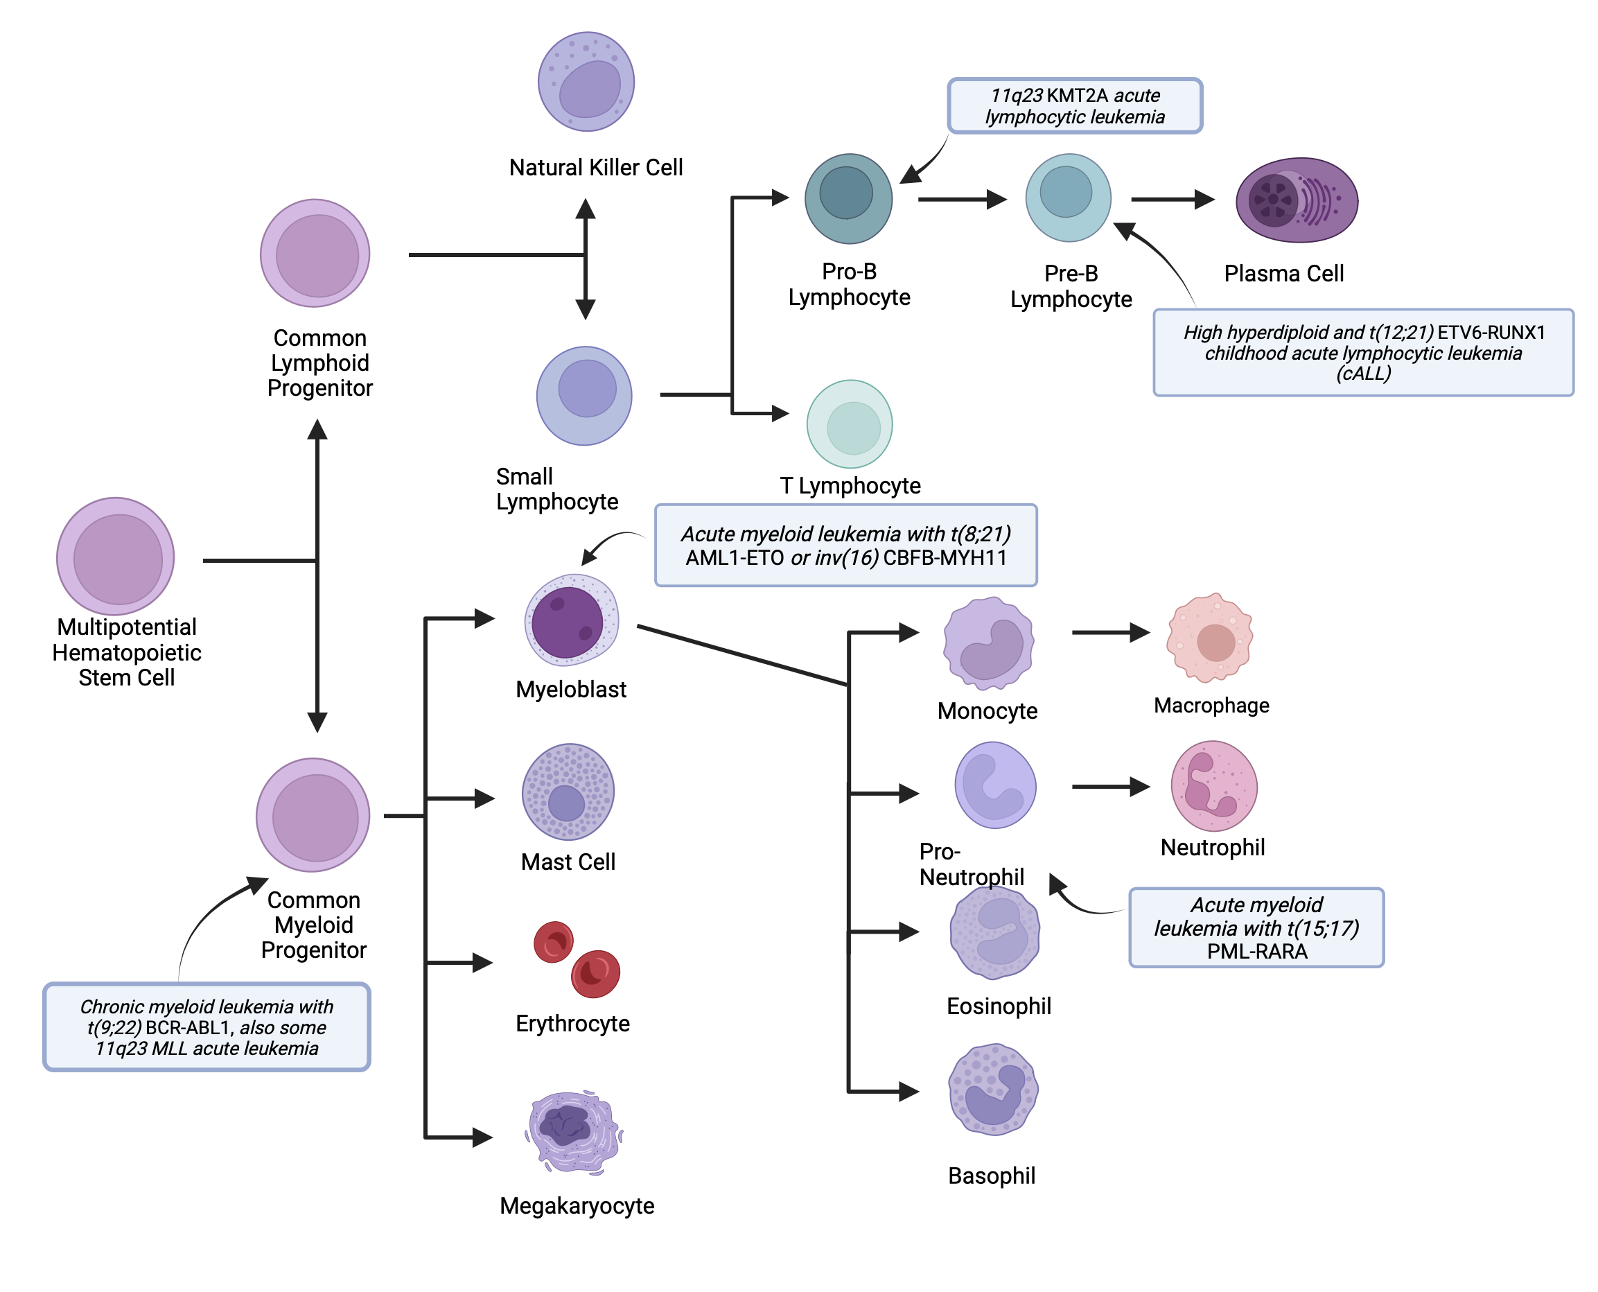
Hematopoiesis and the Immune System
Wiemels J. Perspectives on the causes of childhood leukemia. Chem Biol Interact. 2012 Apr 5;196(3):59-67. Epub 2012 Feb 2. PMID: 22326931.
Notes:
The immune system: Adaptive immunity occurs postnatally and controls how normal enzymes create normal variability. Disruptions occur that mirror common translocations seen in childhood cancer. This mechanism NORMALLY mutates genes for helpful reasons to create mature genes and antibody diversity. These normal processes can go wrong.
RAG – Recombinase Activating Gene – creates antibody diversity.
AICDA – Activation-induced Cytidine Deaminase – causes somatic hypermutations to improve antibody affinity.
TdT – Terminal Deoxynucleotidyl Transferase – add random nucleotides to broken nucleotide sequences to increase antibody and T cell receptor diversity.
When those mutations hit the wrong targets, they can cause mutations that cause leukemia. These “mis-hits” can be caused by inflammation, infection, and chemical exposures.
This poses another question: Do children who develop ALL have an altered immune system and respond to infections differently?
This will be addressed in a later slide.

Slide 18
Hallmarks of Cancer vs.
Key Characteristics of Carcinogens
Hallmarks of Cancer
Key Characteristics of Carcinogens
Sustaining proliferative signaling *
Evading growth suppressors
Activating invasion and metastasis *
Enabling replicative immortality *
Inducing angiogenesis *
Resisting cell death
Electrophilic
Genotoxic
Causes genetic instability
Induces epigenetic alterations
Induces oxidative stress
Induces chronic inflammation
Is immunosuppressive
Modulates receptor-mediated effects
Causes immortalization
Alter cell proliferation, death, or nutrient supply
*normal hematopoietic cells already have these features
Hanahan D, Weinberg RA. Hallmarks of cancer: the next generation. Cell. 2011. PMID: 21376230.
Smith MT, et al. The Key Characteristics of Carcinogens: Relationship to the Hallmarks of Cancer, Relevant Biomarkers, and Assays to Measure Them. Cancer Epidemiol Biomarkers Prev. 2020. PMID: 32152214.
Notes:
Some of the hallmarks of cancer cells are also part of normal hematopoiesis. Hence, there is less that needs to go wrong to develop hematologic cancers when compared to other cancers.
The Hallmarks of Cancer: Properties of cancer cells and describe what biology exists in a cancer.
Carcinogens (or agents that induce cancer) are thought to act by inducing multiple hallmarks in normal cells – transforming them into cancer cells.
Key Characteristics of Cancer: Properties of human carcinogens that induce cancer. They describe the actions of carcinogens that can cause those hallmarks to become acquired.

Slide 19
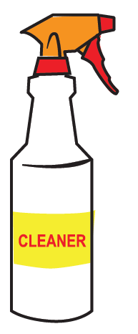
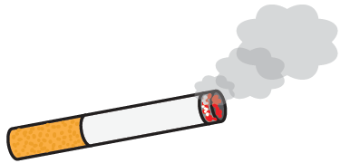
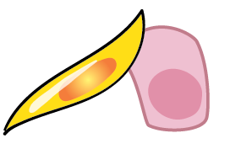


Chemicals, Mixtures and Pathogenesis
Carcinogens may exert preneoplastic influences on:
Stromal cells, fibroblasts and endothelial cells
Adaptive immune system
Secreted molecules
Casey SC et al. The effect of environmental chemicals on the tumor microenvironment. Carcinogenesis 2015. PMID: 26106136.
Goodson WH 3rd, et al. Assessing the carcinogenic potential of low-dose exposures to chemical mixtures in the environment: the challenge ahead. Carcinogenesis. 2015. PMID: 26106142.
Notes:
Carcinogens promote tumorigenesis by targeting multiple components in the tissue, and subsequently, the tumor microenvironment.
Carcinogens may exert preneoplastic influences on various cell types within the tissue, such as stromal cells, fibroblasts and endothelial cells.
Carcinogens may affect the innate (antigen-presenting cells) and adaptive (B, T lymphocytes) immune systems, as well as their secreted molecules.
Carcinogens may encourage angiogenesis and chronic inflammation, which fuel the growth and evolution of the neoplastic cells.
The development of cancer is a multi-step process. Some chemicals tested alone may not induce cancer, but when combined with other mutagens that cause cancer, may show very different results.
As such, a sustained focus on the carcinogenicity of individual chemicals may miss synergies that might reasonably be anticipated to occur when combined with other disruptive chemicals.

Slide 20
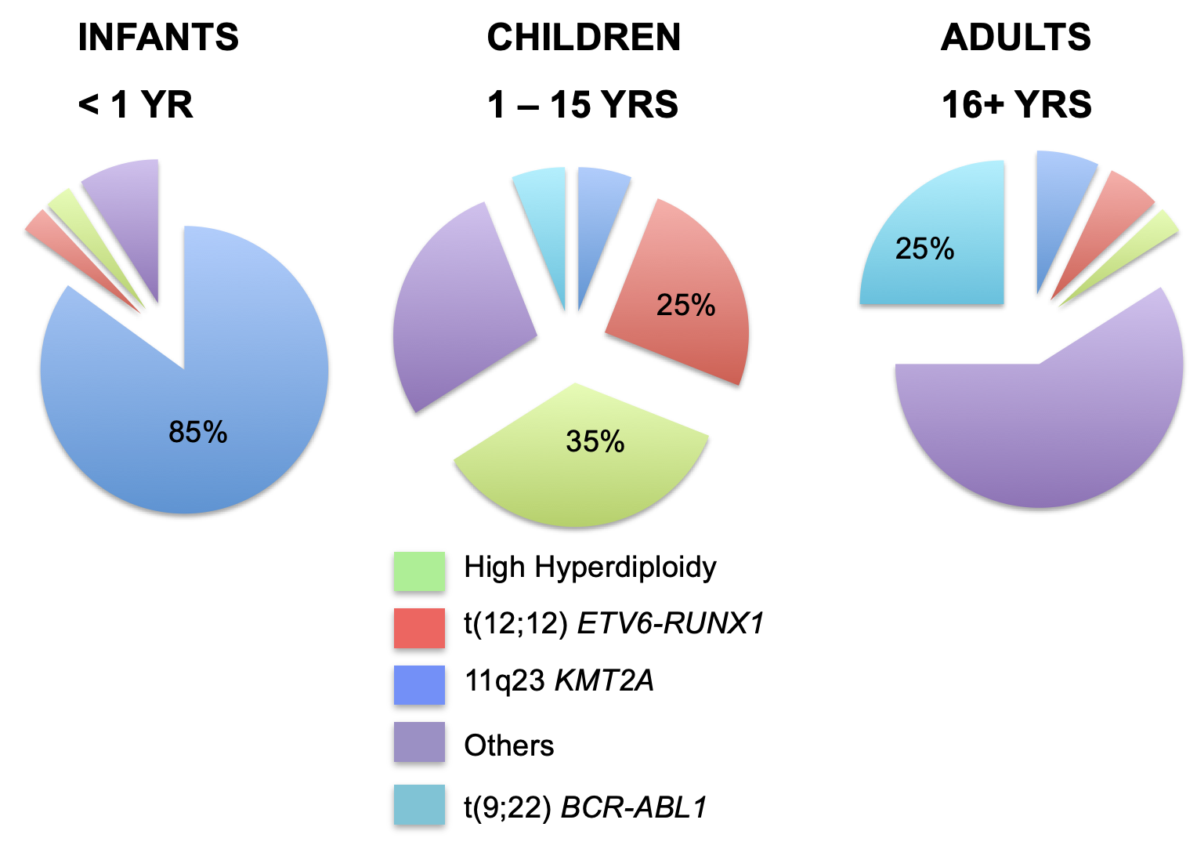
Genetics and Childhood ALL
Wiemels J. Perspectives on the causes of childhood leukemia. Chem Biol Interact. 2012 Apr 5;196(3):59-67. Epub 2012 Feb 2. PMID: 22326931.
Notes:
The rarity of the pediatric cancer in addition to the existence of biologically distinct subtypes that might not share common causative mechanisms complicates matters.
For example, in infants, ALL is usually associated with MLL (KMT2A) rearrangement, and the remarkably high concordance rate in monozygotic twins (approaching 100%) suggests that leukemogenesis is largely complete at birth.
By contrast, the incidence of non MLL-rearranged B ALL peaks between 2 and 5 years and has a concordance rate of 10–15% in monozygotic twins. This suggests that although initiation in utero usually occurs, other so-called promotional exposures are probably necessary for disease emergence.

Slide 21


Environmental Risk Factors:
Childhood Cancer Generation
Immune regulation and infection
Diet – mother and child
Environmental exposures:
  VOCs: benzene, paints, and solvents
  Tobacco smoke
  Air pollution
  Pesticides
  Plastics/Cosmetics - Pthalates
Notes:
Outline of environmental factors to be discussed in upcoming slides: protective and risk.

Slide 22

Immune Regulation and Infection
BIRTH ORDER
  C-section (CS), mode of delivery, and birth order are predictive of ALL risk (Pombo-de-Oliveira ME, et al)
    Vaginal, non-first (reference)
    Vaginal, first: OR 1.21 (95% CI: 0.61 – 2.41)
    CS, non-first: OR 1.74 (95% CI: 0.86 – 3.53)
    CS, first: OR 2.41 (95% CI: 1.20 – 4.84)
    CS, non-BF: OR 2.37 (95% CI: 1.18 – 4.76)
INFECTION AND DAYCARE EXPOSURE
  Meta-analysis of 15 studies examining early exposure to large daycare setting reduces risk over 20% (Urayama KY, et al)
Pombo-de-Oliveira MS, et al. The Interplay of Cesarean-Section Delivery and First-Birth Order as Risk Factors in Acute Lymphoblastic Leukemia. Cancer Epidemiol Biomarkers Prev. 2023. PMID: 36525650.
Urayama KY, et al. A meta-analysis of the association between day-care attendance and childhood acute lymphoblastic leukaemia. Int J Epidemiol. 2010. PMID: 20110276.
Notes:
Mode of delivery: There is a higher risk of B-ALL in children with elective C-section (CS) compared to vaginal birth. This is thought to be related to exposure of the maternal microbiome during vaginal delivery. Another possibility is the stress of birth (however, this is a less favored hypothesis).
Birth order is another protective factor. Later born children have been shown to have a lower risk of B-ALL (this is thought to be due to infectious exposures).
There is a similar effect and synergistic when looking at of type of birth and birth order and breastfeeding combined.
There is strong support in meta-analyses for an association between exposure to common infections in early childhood and a reduced risk of ALL, over 20% risk reduction. The earlier in age a child starts daycare and the more children in the daycare, the more protection from ALL. Protection factors are likely associated with more immune programming in the setting of more frequent infections.

Slide 23
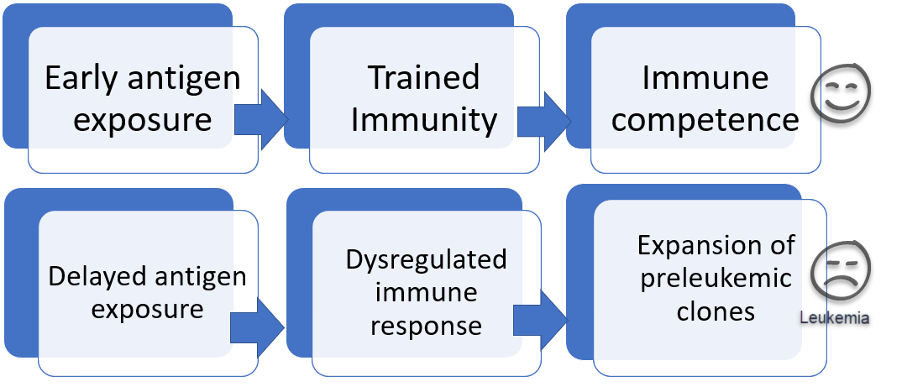
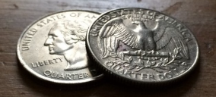
Immune Regulation and Infection
More severe infection
  An increased risk for ALL development was seen in children with confirmed infectious diagnosis in the first year of life (Crouch S, et al)(Chang JS, et al)
Crouch S, et al. Infectious illness in children subsequently diagnosed with acute lymphoblastic leukemia: modeling the trends from birth to diagnosis. Am J Epidemiol. 2012. PMID: 22899827.
Chang JS, et al. Medically diagnosed infections and risk of childhood leukaemia: a population-based case-control study. Int J Epidemiol. 2012. PMID: 22836110.
Notes:
The Crouch et al study (A national population-based study out of the UK) not only included parent information, but information from the primary care provider. Going to the doctor specifically for infections and treated for infections were more common in children that were diagnosed with ALL. Similar results were seen in Chang and colleagues' study (that used the National Health Insurance Research Database of Taiwan): Having more infections and more clinical visits for infection was associated with a higher risk of development of both ALL and AML.
This is a bit of a paradox. Maybe the severity of the infection is key? Not just exposure to more infections, but more outward signs of illness. Maybe children with leukemia have a dysregulated immune system present at an early age (potentially even at birth – maybe even due to “mis-hits” of the enzymes discussed in prior slides), resulting in more symptomatic infections compared with healthy controls.
This paradox illustrates that infections may have a dual role in the genesis of leukemia, one being adaptive and one being maladaptive.

Slide 24
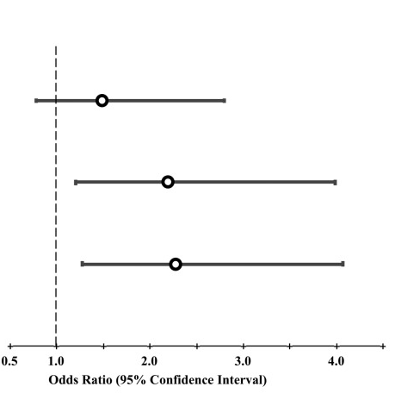

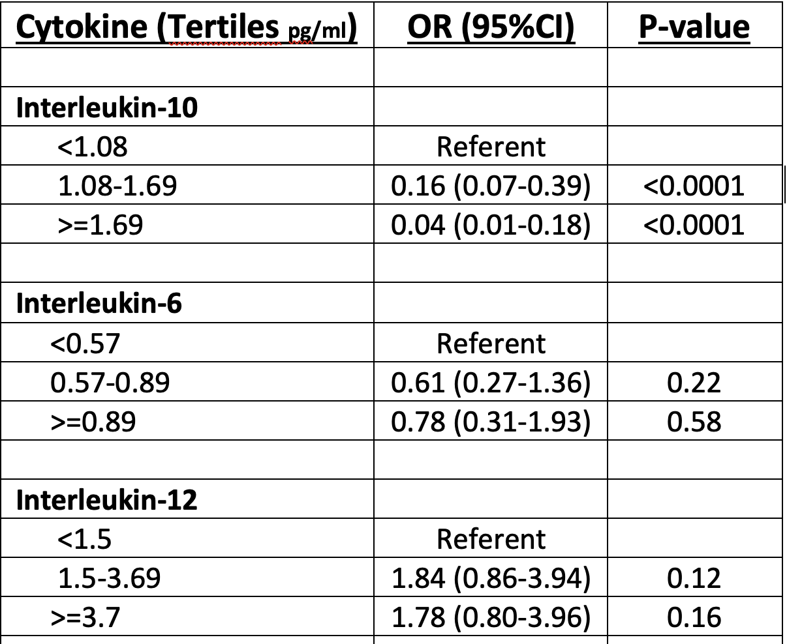
Perinatal Immune Development and Future Risk of Childhood Leukemia
Arginase-2 is increased, and Interleukin-10 is decreased at birth in children who contract ALL later in childhood
Quartile 1 (reference)
Quartile 2 - OR = 1.49 (0.79-2.80)
Quartile 3 – OR = 2.20 (1.21-3.99)
Quartile 4 – OR = 2.28 (1.28-4.07)
Haematologica. 2019 Nov;104(11):e514-e516
Cancer Epidemiol Biomarkers Prev. 2011 Aug;20(8):1736-40
Notes:
Looking a bit deeper into the question of: Do children who develop ALL have an altered immune system and respond to infections differently?
When looking at important regulators of prenatal immune development on birth blood spots:
Arginase 2 (suppresses T-cell function through an anti-inflammatory cascade resulting from arginine depletion): Children with higher arginase 2 levels at birth had a statistically significant increased odds of subsequent development of ALL
IL-10 (key regulator in modulating the intensity and duration of immune responses to infections) was found to be profoundly deficient at birth in children that developed ALL compared to controls.
There was something different about these children at birth. What lead to this abnormal baseline immune function? There are some clues (i.e. viral infections).

Slide 25
Diet
BREASTFEEDING
Several pooled and meta-analyses confirm breastfeeding 6 months and more reduces the risk of childhood leukemia by ~15%
The longer the child is breastfed, the lower the risk
OTHER DIET
A higher intake of folate and other vitamin supplementation is associated with a larger risk reduction in childhood leukemia.
  Maternal supplementation at any time periconception and during pregnancy were associated with a reduced risk of childhood ALL (OR for vitamins 0.85 and folic acid 0.80)
Higher healthy eating index score showed greater reduction in risk of both ALL (OR 0.66) and AML (OR 0.42)
Rudant J, et al. Childhood acute lymphoblastic leukemia and indicators of early immune stimulation: a Childhood Leukemia International Consortium study. Am J Epidemiol. 2015. PMID: 25731888.
Shu XO, et al. Breast-feeding and risk of childhood acute leukemia. J Natl Cancer Inst. 1999. PMID: 10528028.
Greenberg JA, et al. Folic Acid supplementation and pregnancy: more than just neural tube defect prevention. Rev Obstet Gynecol. 2011. PMID: 22102928.
Metayer C, et al. Maternal supplementation with folic acid and other vitamins and risk of leukemia in offspring: a Childhood Leukemia International Consortium study. Epidemiology. 2014. PMID: 25207954.
Singer AW, et al. Maternal diet quality before pregnancy and risk of childhood leukaemia. Br J Nutr. 2016. PMID: 27725005.
Notes:
Breastfeeding has many health advantages for both the mother and the baby, including passage of immune cells and other nutrients. Studies have shown an inverse relationship between length of exclusive breastfeeding and the risk of childhood leukemia.
A variety of fruits and vegetables have nutrients with important anti-cancer properties.
Folate is an essential nutrient for DNA replication and is a substrate for many enzymatic reactions. Folate needs rise during pregnancy and is required for growth and development of the fetus. Folate deficiency has been associated with maternal and fetus abnormalities. Looking at data on prenatal supplementation of folate and other vitamins (from 12 case control studies participating in the Childhood Leukemia International Consortium, CLIC), it was evident that supplementation was associated with a reduced risk of childhood leukemia. This study was large and included almost 7,000 ALL cases, 585 AML cases, and over 11,000 controls.
Looking at maternal diet quality (rather than specific nutrients or food components) as assessed by a quality index score have been used to look at the risk of subsequent development of ALL and AML (in a population-based case-control study in CA, CCLS – CA childhood leukemia study). A strong association between the quality of Mom’s diet and subsequent development of leukemia was found, suggesting that the cumulative diet may be more important than the effect of a single nutrient.

Slide 26
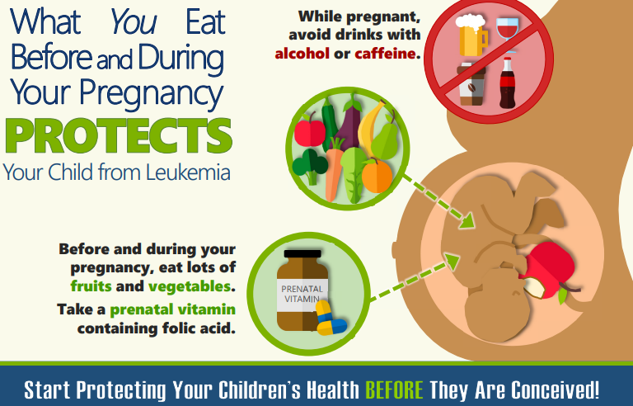
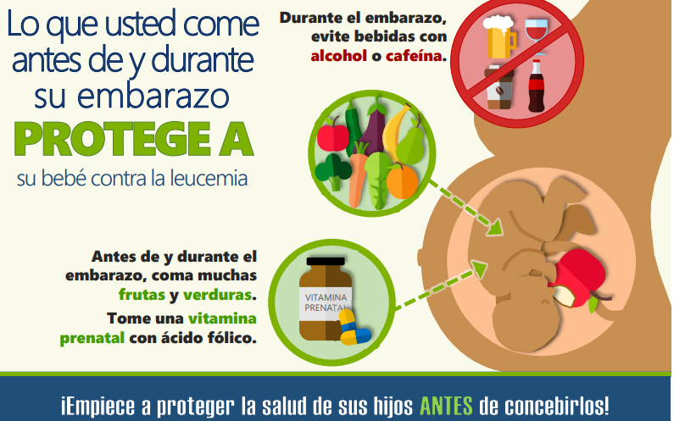
Photo credit: Western States PEHSU. https://wspehsu.ucsf.edu/wp-content/uploads/2018/12/what_you_eat.pdf
Notes:
We can reduce risk prior to and during pregnancy with materials like this developed by our California PEHSU colleagues – encouraging more fruits and vegetables, regular folate intake, less caffeine and alcohol.
It is important to protect a child’s health, even before conception.

Slide 27

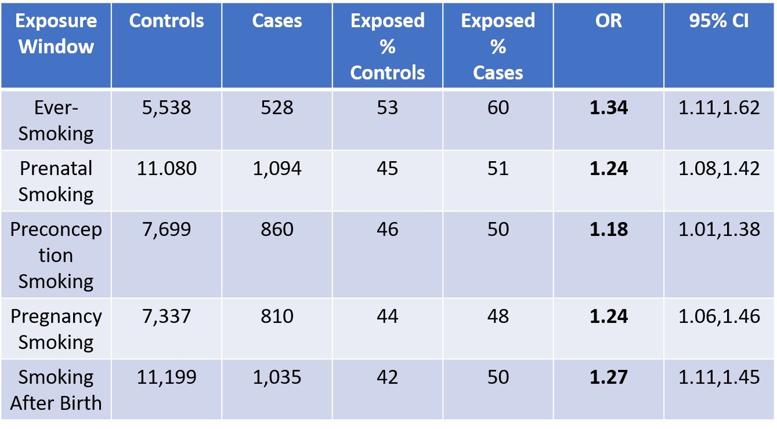
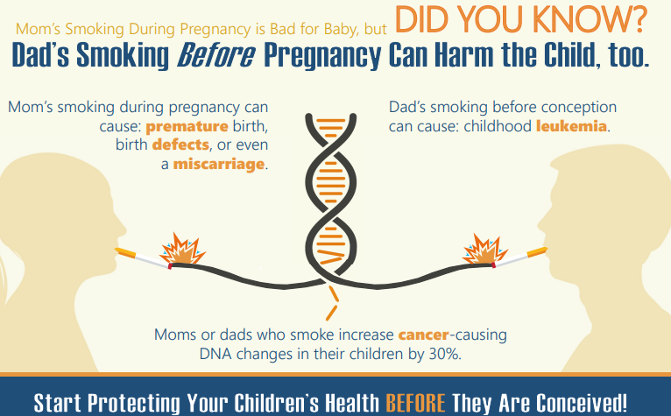

Tobacco Smoke – Paternal
Table: Case-control study of paternal smoking & risk of childhood acute myeloid leukemia – adapted from Metayer
Photo credit: Western States PEHSU. https://wspehsu.ucsf.edu/wp-content/uploads/2018/12/dads_smoking_before_pregnancy.pdf
Metayer C, et al. Parental Tobacco Smoking and Acute Myeloid Leukemia: The Childhood Leukemia International Consortium. Am J Epidemiol. 2016. PMID: 27492895.
Metayer C, et al. Tobacco smoke exposure and the risk of childhood acute lymphoblastic and myeloid leukemias by cytogenetic subtype. Cancer Epidemiol Biomarkers Prev. 2013. PMID: 23853208.
Notes:
Key studies looking at harmful environmental exposure (i.e., tobacco smoke) and association with development of childhood leukemia.
While there are some associations with maternal smoking and risk of CL, the evidence is more consistent and stronger throughout studies for paternal smoking.
The association with tobacco smoke exposure in adults and subsequent development of AML is well established. Historically, there has been less known about the development of AML in children. The Childhood Leukemia International Consortium (CLIC) looked at individual patient-level data on parental tobacco exposure from 12 case-control studies. Pooled analysis of the CLIC studies was done, in addition to meta-analyses of CLIC and non-CLIC studies, which together support the association between paternal smoking and childhood AML.
The table shows pooled risk of childhood AML associated with paternal smoking across time periods. With prenatal exposure associated with the highest risk. What the father does MATTERS!
Other information not shown here but to note from other studies:
Maternal smoking and ALL: Higher association seen in patients with ALL and translocations (as opposed to increased copy number of chromosomes).
A dose-relationship is seen for ALL and AML

Slide 28
Tobacco Smoke and DNA Methylation
DNA Methylation During Early Development
Kesley, G. Epigenome Changes During Development, in: Epigenetic Epidemiology, Michels, et al., Springer, 2012
Notes:
If tobacco smoke is not a direct mutagen, it could be related to methylation.
Paternal tobacco smoke exposure increases the risk of subsequent development of AML. How does this happen? Rather than acting as a mutagen, chemicals contained in tobacco smoke may act through epigenetic changes to cause heritable risks. These heritable changes to the spermatozoa may happen through DNA methylation, which has long been associated with environmental exposures and inheritance of phenotypes.
A study, led by the International Agency for Research on Cancer (IARC), examined the potential of epigenetic (DNA methylation) changes in pre-diagnostic blood samples as a marker of exposure to tobacco smoke in a large multinational cohort (EPIC). The study comprehensively catalogued the smoking-associated alterations in the epigenome and showed that these alterations are reversible, underscoring the benefits of smoking cessation.

Slide 29
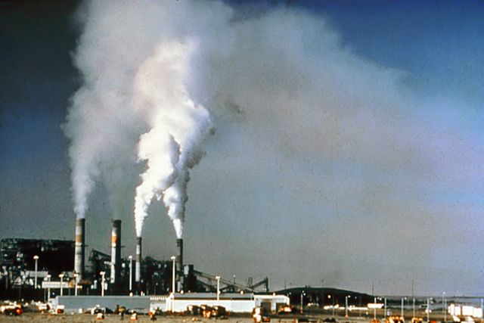
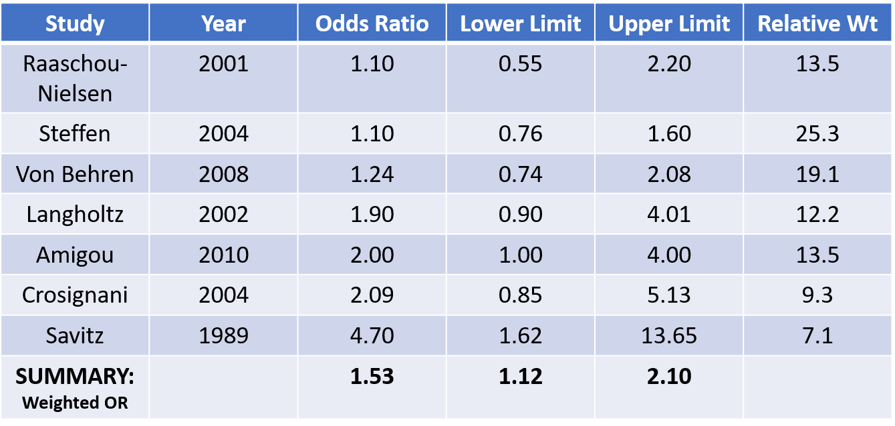
Air Pollution
Photo: Public Domain – Wikimedia Commons
Embryonal Pediatric Cancer Type | OR (95% CI)
Unilateral Retinoblastoma | 1.68 (0.96, 2.93)
Hepatoblastoma | 1.60 (0.80, 3.20)
Neuroblastoma | 1.23 (0.91, 1.67)
Wilms Tumors | 1.14 (0.77, 1.68)
Bilateral Retinoblastoma | 0.72 (0.33, 1.57)
ALL EMBRYONAL TUMORS | 1.24 (1.00, 1.54)
Table: Population-Based Study (TX) of Matera Proximity to Major Roadways & Childhood Embryonal Tumors - adapted from Kumar et al
Table: Meta-Analysis of Traffic Exposure & Childhood Leukemia conducted by the CDC - adapted from Boothe et al
Kumar SV, et al. Maternal Residential Proximity to Major Roadways and Pediatric Embryonal Tumors in Offspring. Int J Environ Res Public Health. 2018. PMID: 29533992.
Boothe VL, et al. Residential traffic exposure and childhood leukemia: a systematic review and meta-analysis. Am J Prev Med. 2014. PMID: 24650845.
Notes:
Many air pollutants are specific chemicals (i.e., sulfur dioxide, nitrogen dioxide, carbon monoxide, and polycyclic aromatic hydrocarbons/PAHs) while others are categories of substances, such as particulate matter (PM, which is defined by size) and volatile organic compounds/VOCs). Pollutants are released from industrial sources, traffic exhaust, and from natural combustion sources (such as wildfires and volcanos).
Hazardous air pollutants (HAPs) include almost 200 chemicals that are known or suspected to cause cancer or serious health problems. These are monitored at industrial sites, but not at a community level.
A population-based study (in TX) evaluated the impact of maternal residential proximity to major roadways (within 500m of major roadway at time of delivery) and showed an increased risk of pediatric embryonal tumors.
A CDC meta-analysis of 7 studies of children living near high traffic roads had a 50% increase in risk for childhood leukemia (Figure on right).

Slide 30


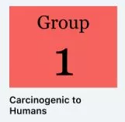
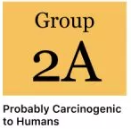
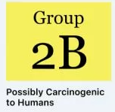
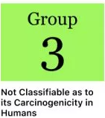
IARC Classifications of Carcinogenic Agents
Group | Definition | # Agents
1 | Carcinogenic to humans | 111
2A | Probably carcinogenic to humans | 66
2B | Possibly carcinogenic to humans | 285
3 | Not classifiable as to its carcinogenicity | 505
4 | Probably not carcinogenic to humans | 1
https://wiki.cancer.org.au/policy/IARC_classifications
IARC. Agents classified by the IARC monographs, volumes 1–108. Lyon: IARC; [cited 2013 Oct 21]. Available: http://monographs.iarc.fr/ENG/Classification/index.php. IARC. Preamble to the IARC monographs - scientific review and evaluation. Lyon: IARC; 2006 Jan 23 [updated 2013 Oct]. http://monographs.iarc.fr/ENG/Preamble/currentb6evalrationale0706.php.
Notes:
Chemicals and how they are categorized.
The international agency for research on cancer (or I-Arc) has a designation system, as seen here, to define risk of carcinogenicity of specific agents. With group 1 showing the clearest links to cancer.

Slide 31
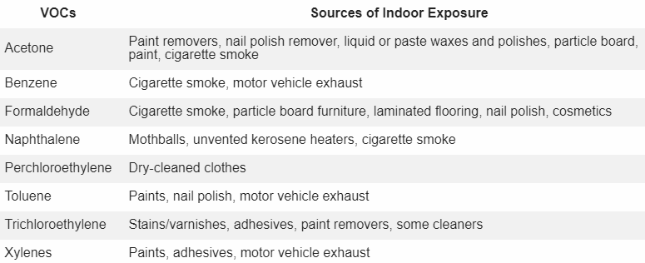
Volatile Organic Compounds (VOCs)
Pediatric Environmental Health - the Toolkit (ucsf.edu)
Notes:
VOCs are carbon compounds that readily produce vapors at room temperature. They are pervasive environmental contaminants because they are found in a variety of industrial and household sources.
Most VOCs are not regulated by the U.S. government, and current measurement techniques have limitations on which VOCs can be assessed easily.
VOCs are found mostly in indoor air, but also outdoor air, water, and some consumer products. Indoor sources of VOCs also include environmental tobacco smoke (ETS), and emissions from fireplaces and coal burning stoves. Recently constructed or renovated buildings tend to have higher VOC levels compared to older buildings. Some common household products also contain VOCs, including household cleaners, degreasers, arts and craft supplies, glues, dry-cleaned clothing, mothballs and nail polish remover. Mold can also release VOCs. Concentrations of VOCs are higher indoors than outdoors, mainly due to poor ventilation.
The items in yellow have been associated with childhood cancer in epidemiologic studies. Toluene and xylene are in paints. Naphthalene is in cigarette smoke. Acetone can be in some paints and is also in cigarette smoke.
Note: the IARC classification for these VOC’s are carcinogens but may be based on adult associations and are not necessarily specific to childhood cancer.

Slide 32

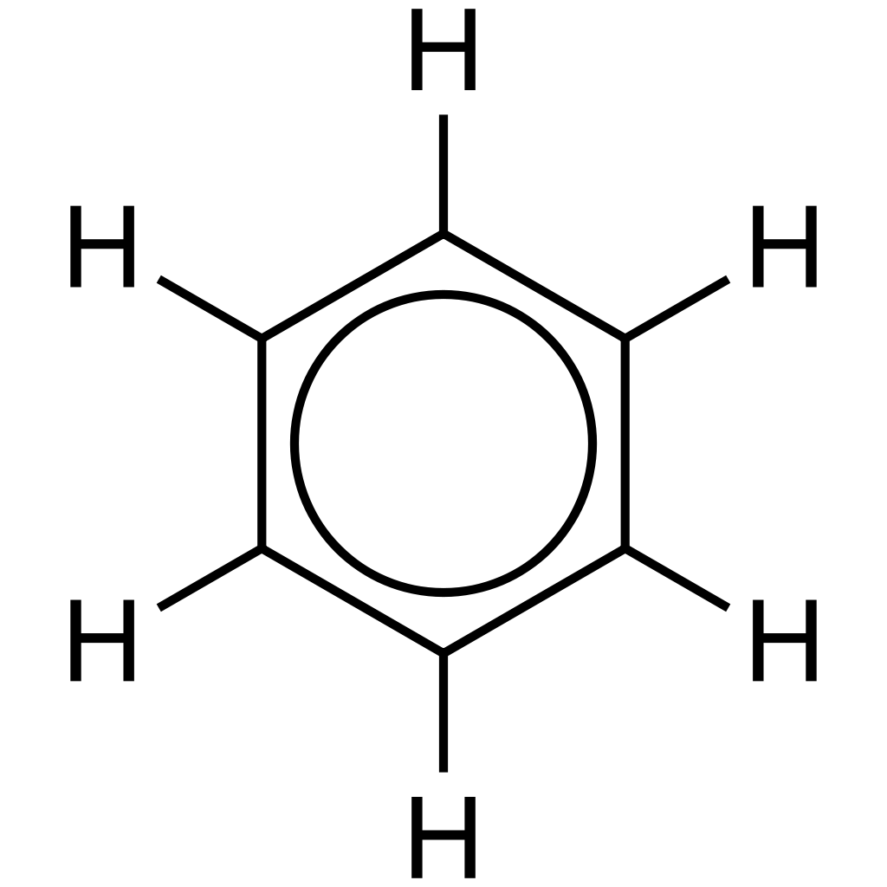
Benzene
Occupational and household exposures
20 studies, 1987-2014
Summary Relative Risk
Traffic related and gas station studies
12 studies, 1999-2014
Summary Relative Risk
Childhood leukemia | 1.96 | 95% CI 1.53, 2.52
AML | 2.34 | 95% CI 1.72, 3.28
ALL | 1.57 | 95% CI 1.21, 2.05
Childhood leukemia | 1.48 | 95% CI 1.10, 1.99
AML | 2.07 | 95% CI 1.34, 3.20
ALL | 1.49 | 95% CI 1.07, 2.08
Detail models of traffic pollution | 1.70 | 95% CI 1.16, 2.49
Simple aromatic hydrocarbon
Occurs naturally and from combustion
Human exposure is widespread
Loomis D, et al. International Agency for Research on Cancer Monograph Working Group. Carcinogenicity of benzene. Lancet Oncol. 2017. PMID: 29107678.
Carlos-Wallace FM, et al. Parental, In Utero, and Early-Life Exposure to Benzene and the Risk of Childhood Leukemia: A Meta-Analysis. Am J Epidemiol. 2016. PMID: 26589707.
Metayer C, et al. A task-based assessment of parental occupational exposure to organic solvents and other compounds and the risk of childhood leukemia in California. Environ Res. 2016. PMID: 27494537.
Notes:
Benzene has been designated as a class 1 carcinogen by IARC. It is a component of tobacco smoke, gasoline, and car exhaust.
Human exposure to benzene is widespread, through the air, in consumer products, and in industry. Benzene is present in several industries and occupations, including the production and refining of oil and gas (such as petroleum), coke production, automobile repair, shoe production, firefighting, and various operations related to engine exhaust.
Benzene is a known carcinogen in adults (specifically, an increased risk of AML). What about children? A meta-analysis done by Carlos-Wallace et al. pooled multiple studies with multiple sources of benzene exposure (including indoor, outdoor, and occupational). They found an association of benzene exposure and risk of childhood leukemia, with an overall 2X increased risk (First figure on left).
Paternal occupational exposure. Increased risk of CL in Latino fathers (not white) offspring when exposed to benzenes, chlorinated hydrocarbons and polycyclic aromatic hydrocarbons/PAH’s/Combustion exhaust. Risk could be from protective equipment not being up to par, Latino’s more commonly doing the dirty work, or could there be a genetic susceptibility that puts the child at higher risk? (Figure on the right).

Slide 33

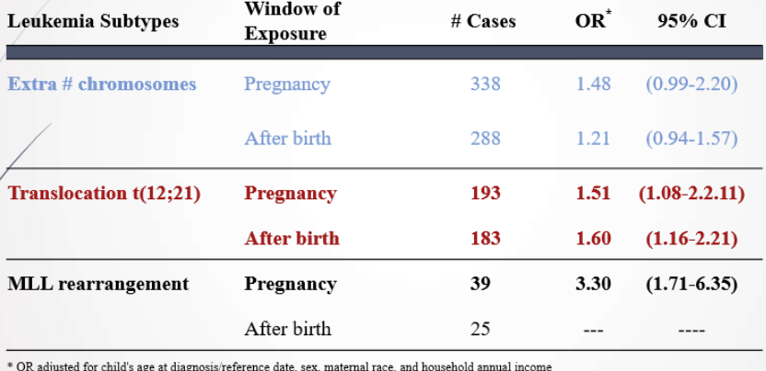
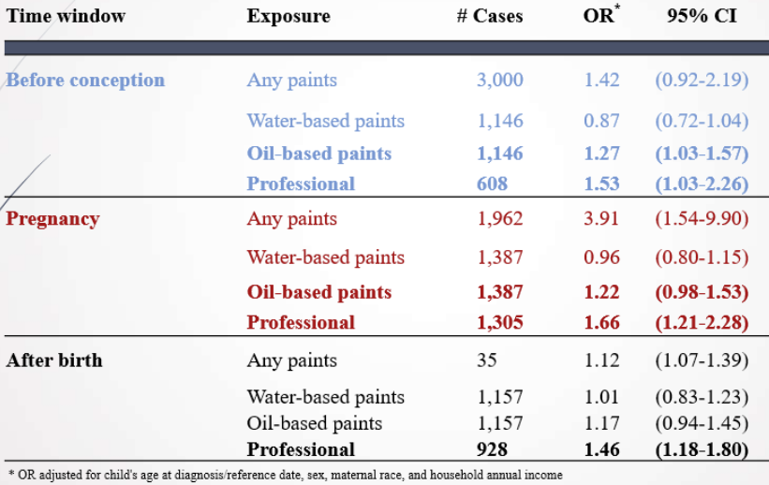
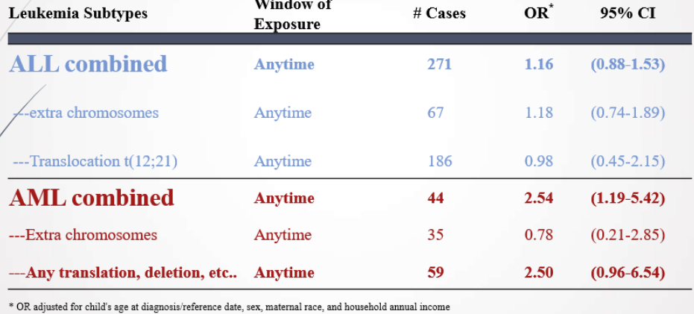

Paints and Solvents
Adapted from: Bailey HD, et al. Home paint exposures and risk of childhood acute lymphoblastic leukemia: findings from the Childhood Leukemia International Consortium. Cancer Causes Control. 2015. PMID: 26134047.
Adapted from: Scélo G, et al.. Household exposure to paint and petroleum solvents, chromosomal translocations, and the risk of childhood leukemia. Environ Health Perspect. 2009. PMID: 19165400.
Notes:
Paints have many individual compounds and some of which are thought to be carcinogenic. About 75% of modern paints are water-based (which is preferred). The remainder are oil-based and contain solvents such as toluene and xylene.
CLIC looked at many cases (3-4k) and controls (from 8 pooled case control studies) that used interview data for home paint exposure at different time points. Cytogenetic subtype data was available for some studies.
Showed 30-60% increased risk of ALL when painting at home and was more likely with oil-based or professional paints (has lots of chemicals and more VOC emission).
The risk was consistent across windows of exposure (before conception pregnancy, after birth).
When looking at risk of ALL based-on cytogenetics (on the right),
Similar results to paint exposure during pregnancy and after birth with ETV6/RUNX1 (t(12;21) translocation are like prior studies. This translocation is thought to occur in utero, as it has been detected in newborn blood samples without subsequent development of CL. Paint exposure could be the primary or the second hit in these cases.
The largest and most significant risk was seen in those with 11q23/MLL rearrangement (breakage in the DNA) and exposure during pregnancy. A majority (almost 70% were ages 2 and under). This increased risk was a novel finding. This rearrangement is seen predominantly in infant ALL, which is thought to originate in utero and is thought to only require a single exposure to trigger disease.
When looking at all solvents (not just paint) and risk of CL, the risk of AML was higher than ALL (which is true in adults as well), especially in those with translocations and deletions (breakage in the DNA) compared to extra chromosomes.

Slide 34
Occupational Pesticides
Acute Lymphoblastic Leukemia (ALL)
Source | Cases (# of studies) | Odds Ratio | 95% CI
Maternal exposure (pregnancy) | 8,236 (12) | 1.01 | 0.78, 1.30
Paternal exposure (peri-conception) | 8,157 (12) | 1.20 | 1.06, 1.38
Acute Myeloid Leukemia (AML)
Source | Cases (# of studies) | Odds Ratio | 95% CI
Maternal exposure (pregnancy) | 1,329 (10) | 1.94 | 1.19, 3.18
Paternal exposure (peri-conception) | 1,231 (10) | 0.91 | 0.66, 1.24
Bailey HD, et al. Parental occupational pesticide exposure and the risk of childhood leukemia in the offspring: findings from the childhood leukemia international consortium. Int J Cancer. 2014. PMID: 24700406.
Notes:
A pooled analysis by CLIC of 13 case-control studies (with over 8,000 cases and 14,000 controls for each mothers and fathers) was done to determine risk of occupational pesticide exposure during pregnancy and around conception and risk of CL (both ALL and AML). The time point of interest was the year before conception for fathers and during the pregnancy for mothers.
Paternal occupational pesticide exposure around the time of conception increased the risk of ALL in offspring. Maternal occupational exposure during pregnancy increased the risk of AML in offspring. The relationship was stronger for children diagnosed before five years of age.

Slide 35
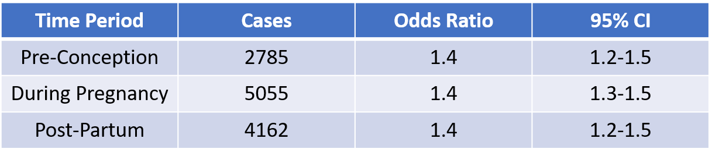
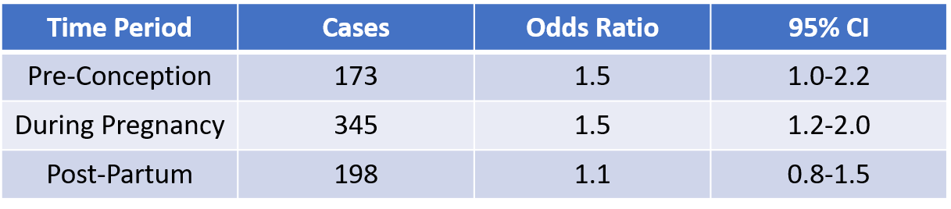
Home use of pesticides
Acute Lymphoblastic Leukemia (ALL)
Acute Myeloid Leukemia (AML)
Adapted from: Bailey HD, et al. Home pesticide exposures and risk of childhood leukemia: Findings from the childhood leukemia international consortium. Int J Cancer. 2015. PMID: 26061779.
Notes:
This CLIC study looked at pooled analysis from 12 case control studies to further investigate the suggestion that home pesticide exposure before birth and in early childhood may increase risk of CL and did find an association with increased risk of both ALL and AML with home use of pesticides.

Slide 36

Phthalates
Phthalates are a group of endocrine-disturbing chemicals used in hundreds of products, from food containers to personal care products. They are used to make plastics more flexible. Exposure is wide-spread.
Several phthalates are now banned from children’s toys.
Pharmaceuticals are another source of phthalates:
A single study using medication records raised concern, showing elevated risk for these rare cancers below:
Cancer | Exposure Period | Cases | Odds Ratio | 95% CI
Osteosarcoma | Childhood | 106 | 2.78 | 1.63, 4.75
Lymphoma (NHL) | Childhood | 153 | 2.29 | 1.33, 3.92
Lymphoma (HD) | Childhood | 69 | 2.04 | 1.01, 4.12
ALL | Gestation | 530 | 1.27 | 0.70, 2.31
Ahern TP, et al. Medication-Associated Phthalate Exposure and Childhood Cancer Incidence. J Natl Cancer Inst. 2022. PMID: 35179607.
Harley Kg, et al. Reducing Phthalate, Paraben, and Phenol Exposure from Personal Care Products in Adolescent Girls: Findings from the HERMOSA Intervention Study. Environ Health Perspect. 2016. PMID: 26947464.
Notes:
Pthalates are another environmental hazard that have been linked to cancer.
In 2008, the consumer product safety act was passed and banned several phthalates from children’s toys in the US. 5 additional phthalates were banned in 2018. The European Union has banned all phthalates from children’s toys for children under 3 years of age.
A recent single study out of Denmark looked at phthalate exposure through pharmaceuticals over a 20-year period. The prescription ingredients were available and merged with cancer registry data. They looked at exposures in pregnancy and childhood and incidence of childhood cancer. They showed a link to osteosarcoma and lymphoma. Leukemia and another group of cancers did not show any increased incidence (Kidney, reproductive organ cancers, CNS, Burkitt lymphoma). There is a lot of heterogeneity in types of phthalates, but they showed certain phthalates that were positive.
What can we take from this small study? Cancer incidence and phthalate exposure evidence in the literature is limited. Small, but well-done studies (like this) are important and provide data for concern. While more studies are needed, adding phthalates to the list of “possible early life carcinogens” and reducing exposure should be encouraged.
Exposure to phthalates is ubiquitous and it may seem challenging to limit such exposure. The center for the health assessment of mothers and children of Salinas) youth council looked at an intervention with Latina teens to reduce exposure to phthalates in personal care products and demonstrated that reduction is feasible to the average consumer.

Slide 37
















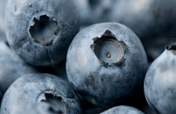







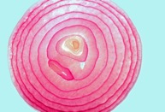


Dirty Dozen
Clean Fifteen
Strawberries
Pears
Bell & hot peppers
Avocado
Papaya
Kiwi
Sweet potato
Spinach
Nectarines
Cherries
Sweet corn
Sweet peas
Cabbage
Watermelon
Kale, collard &
mustard greens
Apples
Blueberries
Pineapples
Asparagus
Mushrooms
Carrots
Peaches
Grapes
Green beans
Onion
Honeydew
Mangoes
https://www.ewg.org. Environmental Working Group
Notes:
Environmental Working Group’s (EWG) 2023 dirty dozen and clean 15 list.

Slide 38
Taking an Environmental History
ACHOO
Activities | School, daycare, after school, sports, grandparents, place of worship
Community | Industry, agriculture, dump site, water pollution, water source (city, well, bottled, filters)
Household | Dwelling (basement, asbestos, radon, formaldehyde), age (lead possible before 1978 but higher levels 1950-60s), condition (mold, CO2 monitor), heating sources, pesticide use (outdoor and indoor), secondhand smoke
Hobbies Occupation | Arts, crafts, model building, fishing Known exposures to fumes, dusts, or vapors. Shower at home or change clothes (take home exposures), adolescent and parental employment
Oral Behaviors | Pica, potential hazardous mouthing behavior
Notes:
Some of the work in the POCES project is to spread understanding about the underlying science of childhood cancer and the growing understanding of what role the environment plays. We also promote simple mnemonics, like this one, ACHOO, to encourage clinicians to take an environmental history and raise everyone’s awareness, even when we do not have all the answers.

Slide 39

“We want to have more kids. What can we do to decrease their risk for cancer?”
"Did I do something to cause my child's cancer?“
"I just read that paint fumes can increase cancer risk. We painted the nursery when I was pregnant, and now I am devastated."
"Do environmental exposures cause cancer in children?"
“I quit smoking when I was pregnant. But could that have anything to do with my child's cancer?"
Notes:
88% of providers report getting questions from families (and HALF were uncomfortable discussing with families).
92% said they would find it helpful to have information about environmental exposures.
Childhood cancer and environmental exposures is a teachable moment not only for clinicians, but nurses, and families as well.
National academy of science defines risk communication as the interactive process of exchange of information and opinion. There are components of risk communication that are worth noting, as they are pertinent here:
Trust - Clinicians are generally considered trusted messengers.
Cognitive noise – when we are worried, we don’t listen or remember well. During the initial diagnosis, there is a lot of cognitive noise. As their journey continues, this cognitive noise dies down, and families will have the bandwidth to start wondering and asking questions and engaging in dialogue.

Slide 40

Right time and place
Be collaborative
Normalize the feeling
  “of course, you would worry about that.”
Honor the parent
  “it is clear what a loving parent you are and that you want to do everything you can to protect your child. I applaud you.”
Express empathy
  “I am sorry this is weighing on you.”
Show respect by asking permission
  “Can I share my thoughts about this”
Alleviate guilt
  “Many children have these exposures, but only few go on to develop cancer. Cancer is caused by numerous complex factors, and we cannot pinpoint exactly what the cause was. Please know that you did not cause this by smoking or painting your child’s nursery”
EMPOWER
  “That said, knowledge is power. You can use what you learn to support your child through their cancer treatment now. You can make your child’s world safer with respect to these risks that you now know about.”
Notes:
You can address these questions in the moment but may also circle back with them, especially when that cognitive noise dampers.

Slide 41

Environmental Exposures
Prevention
Let fresh air in.
Clean with care.
Store chemicals carefully.
Limit smoke exposure.
Shop smart
Avoid exposures
Notes:
Families can lower risk for childhood cancer and other diseases by preventing or minimizing exposure to environmental hazards when possible.
Let fresh air in: Ventilate your home when using solvents and VOCs (such as cleaning products or new paint) or after installing products that contain VOCs such as manufactured pressed wood products. Check out the air quality index and limit outdoor activity when air quality is poor.
Clean with care by avoiding dry cleaning clothes, when possible. Instead try hand-wash at home, or look for dry cleaners that provide wet cleaning, or CO2 cleaning. Air out dry-cleaned clothes outdoors before wearing or putting them in the closet. Dust with microfiber cloths and make sure vacuum cleaners have a HEPA filter, to avoid dispersing dust back into the air.
Store chemicals (such as cleaning products, paints and varnishes, fuels) out of reach of children. Always store chemicals in their original container and tightly sealed. Dispose of cleaning products and paints that are no longer needed.
Reduce or eliminate tobacco smoke exposure (including e-cigarettes and other vaping devices). Do not allow smoking inside house or cars.
Shop Smart: VOCs are chemicals that are widely used as ingredients in household products. Choose “low-VOC” products, such as unscented products and water-based glues and paints. Always ventilate your home if you are painting indoors. Choose safe arts and crafts products for schools and home. Choose alternative home products, such as those with an EPA safer choice label.
Decrease pesticide exposure from the diet. Wash and scrub produce with water, throw away the outer leaves of leafy vegetables where pesticide residues are highest, and trim the skin and fat from poultry, fish, and meats where pesticides can collect. Purchase organic foods, when possible, but not at the expense of a diet rich in a variety of fresh fruits and vegetables. Use the EWG’s dirty dozen and clean 15 list to shop smart.
Avoid exposures prior to pregnancy, during pregnancy, and during childhood. Remember, conception is a ‘window of vulnerability.’ Pregnant women should attempt to minimize their exposure to solvents and VOCs in the home and workplace.
As discussed earlier, few clinicians take an environmental history and even fewer ask about specific exposures. These questions could have a role, not only in general pediatrics (prior to a cancer diagnosis) but also after a diagnosis of childhood cancer is made. Reductions after diagnosis can lead to reduction of secondary harms, improved quality of life and survivorship, and even protecting younger and future siblings.

Slide 42
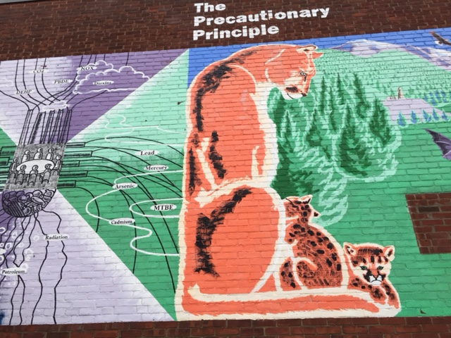
The Precautionary Principle
UNESCO (United Nations educational, scientific, and cultural organization, 2005): The precautionary principle: if there is possibility of unacceptable harm, that is scientifically plausible but uncertain, actions should be taken to avoid or diminish that harm. Actions taken should be proportional to the perceived level of arm with systemic consideration of the consequences, both positive and negative.
  Scientifically based
  Thinking about the pros and cons in a broader context
  Making sure the effort behind the action is reasonable
  Go slow and ask smart questions.
Risk factors and potential associations discussed should be addressed, if not for risk reduction in childhood cancer, but for other known reasons:
  Pesticides – asthma, neurodevelopmental disorders
  Tobacco – SIDS, asthma, LRI, preterm and low birth wt., lung and breast cancer
  Traffic – asthma, lung function growth, neurodevelopment (autism)
  Solvents – neurodevelopment, asthma, cancers
  Folate – neural tube defects, autism
Photo credit: Alan Woolf, with permission
Notes:
PRE●CAU●TION (Webster dictionary): Something that is done to prevent possible harm or trouble from something happening in the future.
When we ask ourselves, “what the consequences of our actions might be” and “what we can do to reduce the risk of consequences we don’t like” we are exercising precaution.

Slide 43




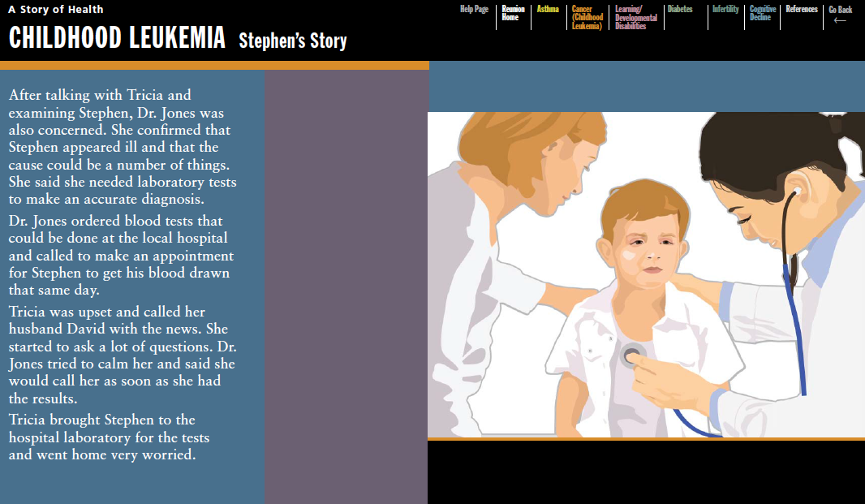

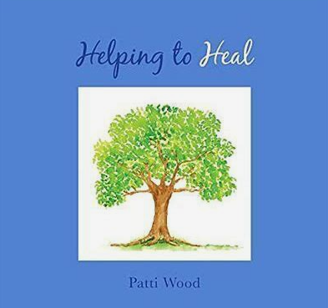
Additional Resources
cehn.org
helping2heal.org
Story of Health with permission: https://wspehsu.ucsf.edu
Notes:
Clearya is a free app that allows you to browse your favorite online shops (such as amazon, target, Walmart, Sephora) for personal care and other products. The app flags hazardous ingredients based on regulation and science by automatically analyzing product ingredient lists.
Childhood environmental health network (advocacy): Mission: protect the developing child from environmental hazards and promote a healthy environment.
Helping to heal by Patti Wood: a short and easy to read book for parents of patients with serious illnesses that focuses on child’s diet and environment.
Learn more about environmental issues and strategies to reduce risk at the website of the US Environmental Protection Agency.

Slide 44

Key Take Aways
The incidence of many cancers in children and adolescents is increasing in most industrialized countries.
In addition to genetic vulnerabilities, environmental triggers are an important cause of childhood leukemias and other cancers.
Early life exposures (pre-and post-natal) must be considered in etiologic studies.
Some environmental exposures to carcinogens in childhood manifest after a long latency as cancers later in adulthood.
Pediatric health care professionals should counsel families on ways to reduce children’s vulnerabilities and increase children’s resilience against the development of childhood cancers.
Promoting a healthy diet and lifestyle for children and their families and encouraging breast-feeding are important in counseling and empowering families in childhood cancer reduction.
Avoiding known cancer-causing chemicals, such as benzene, tobacco smoke, paints and solvents, air pollutants, pesticides, household radon, and other environmental hazards, are important strategies that will reduce the incidence of childhood cancers.
Even small changes in a child’s diet and environment can be very beneficial.
Notes:
We have a lot to learn, but it is not too early to start equipping clinicians.
A new cancer diagnosis in a child is shocking and families go into crisis mode. However, when that cognitive attenuation (that mental noise) tempers a bit, many families have expressed interest in being offered resources, particularly as they move into survivorship (which many childhood cancer patients do).

