Slide 1
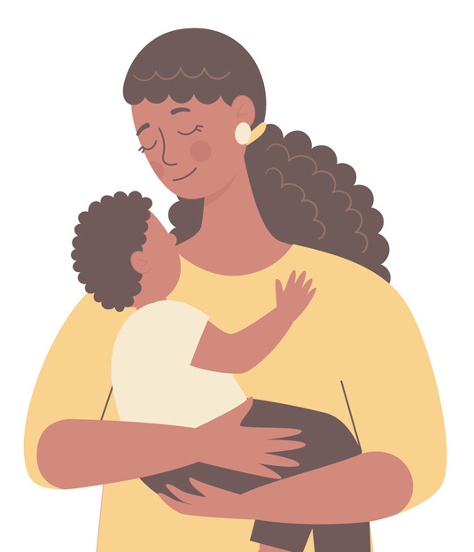


Get the facts about reducing risk of childhood cancer

Slide 2
Welcome
I’d like to talk to you today about children’s cancer, like leukemia, because it’s been increasing a lot over the past years.
I’m going to focus on environmental toxic chemicals.
We’ll start by looking at what is cancer and different types of childhood cancer.
Some things that might contribute to the risk for getting it.
Why children are at greater risk from toxic chemicals.
Specific pollutants including outdoor and indoor air pollution, pesticides and solvents such as paints.
Actions families can take to help reduce the risk of their kids developing cancer.
■
■
■
■
■
Let’s take a look.
P E D IA T R I C E N V I R ONME N T AL H E AL T H S P E C IAL T Y UN I T S
Educator i

Slide 3
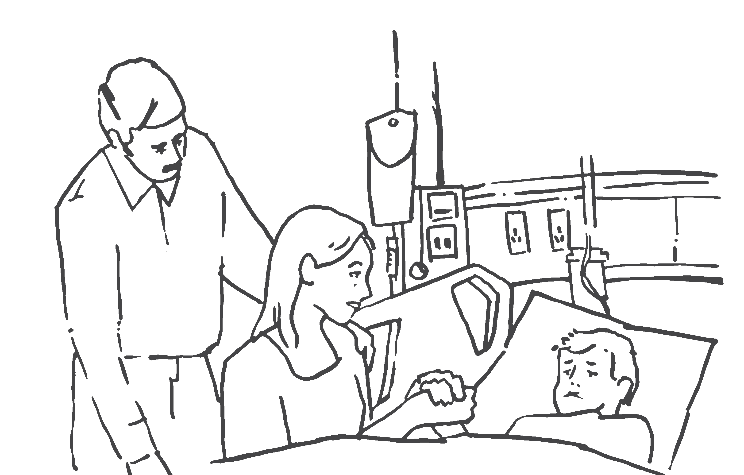
Welcome
I’d like to talk to you today about children’s cancer, like leukemia, because it’s been increasing a lot over the past years.
Learner i
C H I L D H O OD C ANC E R AND T H E E N V I R ONME N T

Slide 4
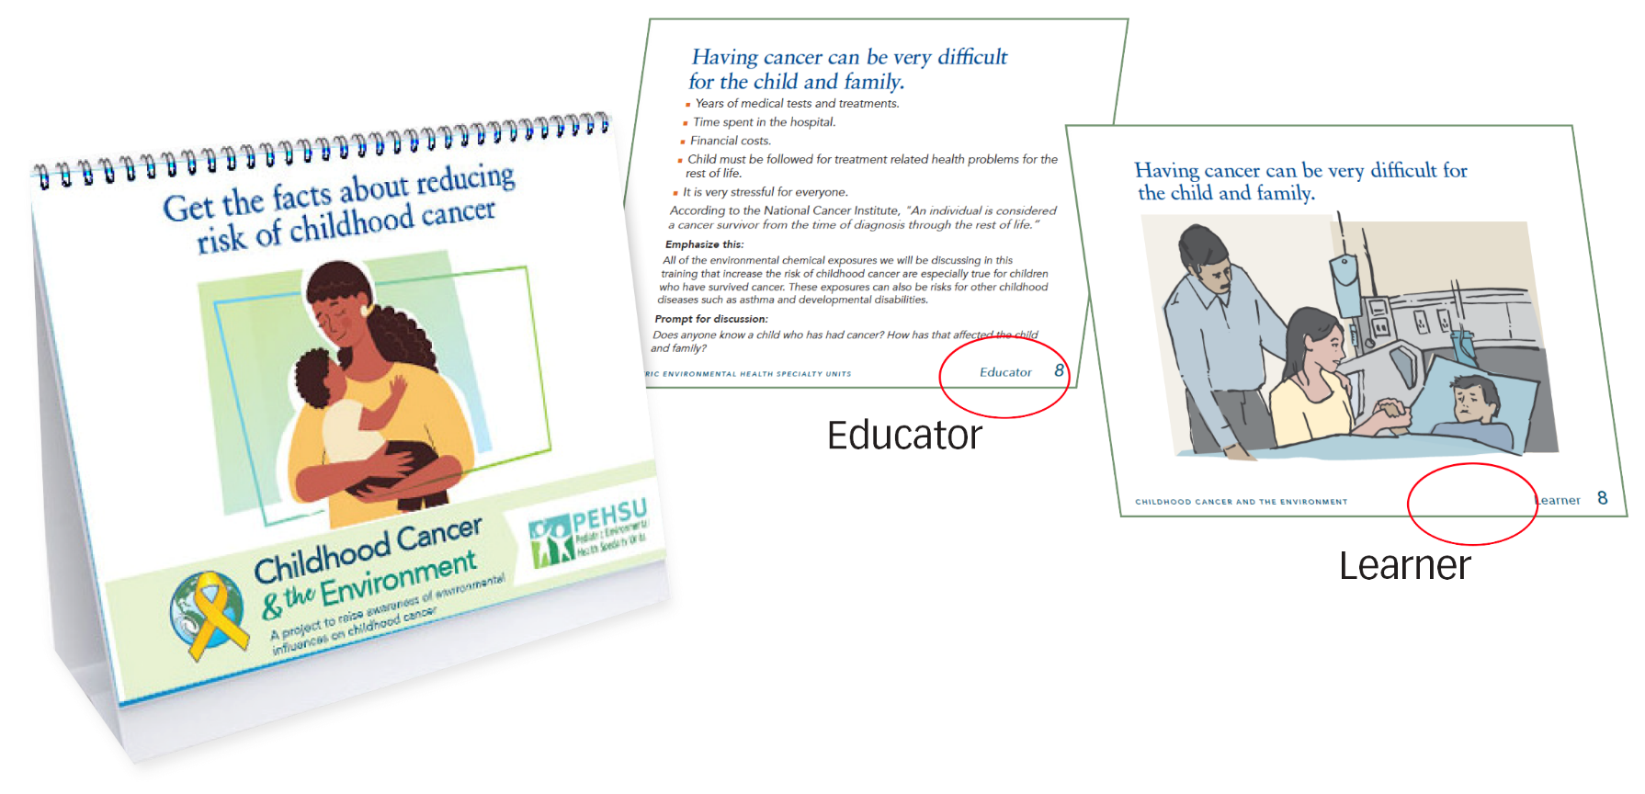
Flipbook: A Tool for Community Health Workers
This is the flip book we created for Childhood Cancer & the Environment.
The side facing you will have your “script” with the needed information.
The side facing your audience/community members will have the simplified images and bullet points related to the information you will cover.
Educator ii
P E D IA T R I C E N V I R ONME N T AL H E AL T H S P E C IAL T Y UN I T S

Slide 5
Flipbook: A Tool for Community Health Workers
This is the flip book we created for Childhood Cancer & the Environment.
The side facing you will have your “script” with the needed information.
The side facing your audience/community members will have the simplified images and bullet points related to the information you will cover.
Learner ii
P E D IA T R I C E N V I R ONME N T AL H E AL T H S P E C IAL T Y UN I T S

Slide 6
What is Cancer?
“Cancer” is used to describe a group of diseases in which abnormal cells reproduce without control and invade nearby tissues.
Cells spread to other parts of the body through the blood circulation and the lymph system.
The lymph system is part of the immune system and looks similar to the circulatory system as you can see in the drawing.
■
It collects waste products, bacteria, and damaged cells so that they can be destroyed or removed from the body.
Educator 1
P E D IA T R I C E N V I R ONME N T AL H E AL T H S P E C IAL T Y UN I T S

Slide 7
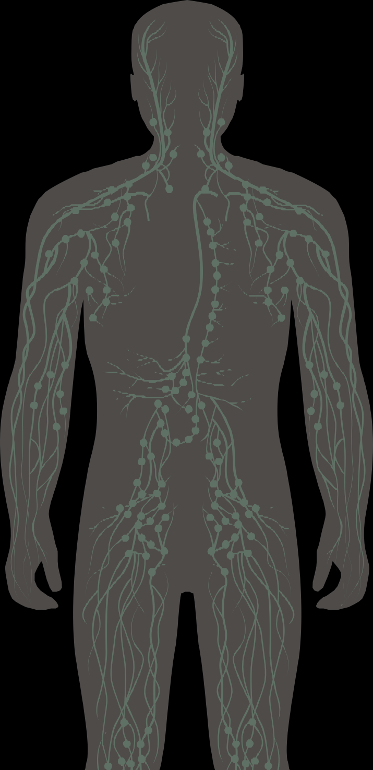
What is Cancer?
The Lymph
cervical
thoracic duct
System
“Cancer” is a group of diseases in which abnormal cells:
lymph
nodes
Reproduce without control, Invade nearby tissues,
Spread to other parts of the body through the blood and lymph systems.
lymphatics of
thymus
the mammary
gland
auxiliary
■
lymph
nodes
■
cisterna
chyli
^{spleen} lymphatics
lumbar
of the
lymph
upper limb
nodes
inguinal
pelvic
lymph
lymph
nodes
nodes
lymphatics of the lower limb
C H I L D H O OD C ANC E R AND T H E E N V I R ONME N T
Learner 1

Slide 8
What is Cancer?
Normally, cells grow and divide in an orderly process.
Cells are tiny structures that make up our organs and body. When normal cells grow old or get damaged, they die, and new normal cells take their place. The body makes more cells only when it needs them.
When a child has cancer, abnormal (cancer) cells grow and divide in an uncontrolled way.
For example:
New, abnormal, cells form when the body doesn’t need them.
Old or damaged cells don’t die when they should.
Cancer cells invade and damage nearby tissues and spread to other parts of the body.
■
■
Educator 2
P E D IA T R I C E N V I R ONME N T AL H E AL T H S P E C IAL T Y UN I T S

Slide 9
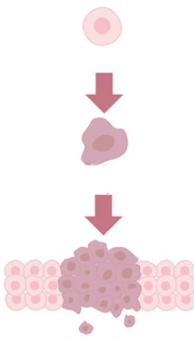
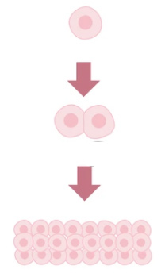
What is Cancer?
Normally, cells grow and divide in an orderly
normal vs. cancer cell development
normal cell
Process.
normal cell
When a child has cancer, abnormal (cancer) cells grow and divide in an uncontrolled way.
mutation
cell division
healthy tissue
Learner 2
C H I L D H O OD C ANC E R AND T H E E N V I R ONME N T

Slide 10
What are the most common childhood cancers?
Cancer, and the health problems caused by cancer treatment, are among the leading causes of serious illness and death in children and teens.
The most common childhood cancers are:
Leukemia is the most common childhood cancer. It starts in the blood-forming tissue of the bone marrow.
Brain cancer Brain and spinal cord tumors begin in the tissues of the brain and spinal cord.
Lymphoma is the most common teen cancer. It starts in the lymphatic system, which is part of the body’s immune system that fights disease.
Neuroblastoma forms in nerve tissue in the neck, spinal cord, or adrenal glands (glands that help regulate systems in your body).
Sarcoma is cancer that forms in the bone, muscle, or soft tissues.
Wilms tumor and other childhood kidney tumors
■
■
■
■
■
Educator 3
P E D IA T R I C E N V I R ONME N T AL H E AL T H S P E C IAL T Y UN I T S

Slide 11



What are the most common childhood cancers?
Brain
Eyes (retinoblastoma)
The most common childhood cancers are:
Lymphoma
Leukemia Brain cancer Lymphoma
Neuroblastoma Sarcoma
Wilms tumor and other childhood kidney tumors
Blood (leukemia)
■
■
Kidneys (Wilms tumor)
Bones (osteosarcoma and Ewing sarcoma)
■
■
■
Adrenal glands (neuroblastoma)
Muscles (Rhabdomyosarcoma)
Learner 3
C H I L D H O OD C ANC E R AND T H E E N V I R ONME N T

Slide 12
Childhood cancer is increasing in the U.S.
46 DAILY - Kids are diagnosed each day 16,000 YEARLY - Kids are diagnosed each year
41% INCREASE - in childhood cancer since 1975
$1.9 BILLION - Cost per year due to hospitalizations which increases insurance costs for everyone
Reference: Childhood Cancer: Cross-Sector Strategies for Prevention. Cancer Free Economy, 2021
Educator 4
P E D IA T R I C E N V I R ONME N T AL H E AL T H S P E C IAL T Y UN I T S

Slide 13


46
Childhood cancer is increasing in the U.S.
16,000
Kids are diagnosed each year
Kids are diagnosed each day
41% $1.9
Increase in childhood cancer since 1975
BILLION
Cost per year due to hospitalizations
Learner 4
C H I L D H O OD C ANC E R AND T H E E N V I R ONME N T

Slide 14
The rate of childhood leukemia has been increasing, especially among Latino children.
In low-income countries many cases of childhood cancer go uncounted and unreported because there are no cancer registries.
This chart shows how from 1988 to 2012 the rates of ALL (leukemia, the most common childhood cancer) rose 35% for Latino children in California.
“From 1988 to 2012, the rate of lymphoblastic leukemia climbed 35% for Latino children in California and 12% for White children.”
Footnote: “In 1998, there were 37 new acute lymphoblastic leukemia (ALL) patients for every 1 million Latino children in California and 32 new ALL patients per 1 million non-Latino White kids. For a particular year, each bed represents one extra new ALL patient per 1 million kids (e.g. there were 14 extra new ALL patients per 1 million Latino kids in 2012 vs. 1988).”
Graphic reproduced with permission from the Center for Integrative Research on Childhood Leukemia and the Environment (CIRCLE)
Educator 5
P E D IA T R I C E N V I R ONME N T AL H E AL T H S P E C IAL T Y UN I T S

Slide 15
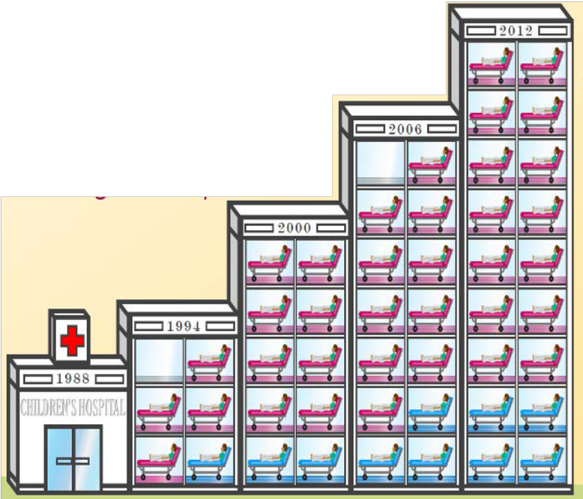
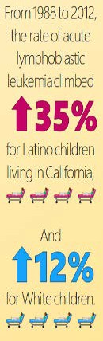

The rate of childhood leukemia has been increasing, especially among Latino children.
Each bed in the infographic represents an additional leukemia case per million kids.
Learner 5
C H I L D H O OD C ANC E R AND T H E E N V I R ONME N T

Slide 16
Other cancers are also increasing, such as brain cancer, the second most common kids’ cancer.
This chart shows a steady increase in brain cancer from 2000-2019 for all children, all races less than age 15.
Citation: SEER* Explorer - An interactive website for SEER cancer statistics [Internet]. Surveillance Research Program, National Cancer Institute. Available from https://seer.cancer.gov/statistics-network/explorer/
Educator 6
P E D IA T R I C E N V I R ONME N T AL H E AL T H S P E C IAL T Y UN I T S

Slide 17
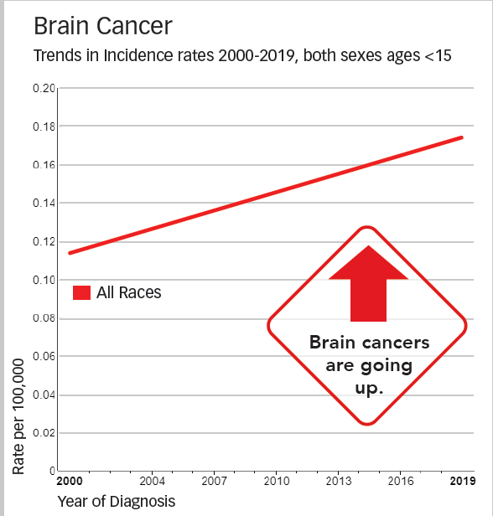
Other cancers are also increasing, such as brain cancer, the second most common kids’ cancer.
Learner 6
C H I L D H O OD C ANC E R AND T H E E N V I R ONME N T

Slide 18
More kids survive cancer than ever before, but survivors have greater health risks for the rest of their lives.
Children should be closely followed in survivorship clinics.
(Survivorship clinics are places that specialize in follow-up care for kids who have been treated for cancer.)
It used to be that only 1 in 10 children with leukemia survived for five years. Now it’s 9 in 10 in high income countries (it is still much less than that in low-income countries). For some cancers, survival rates have not gotten much better.
Educator 7
P E D IA T R I C E N V I R ONME N T AL H E AL T H S P E C IAL T Y UN I T S

Slide 19
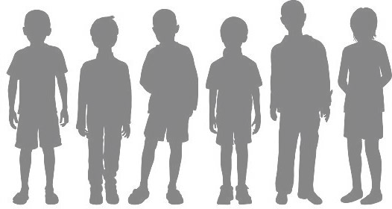
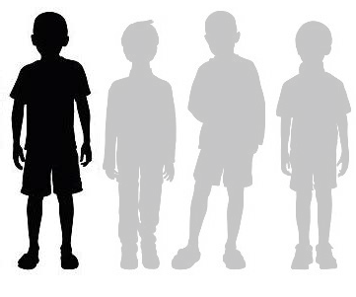
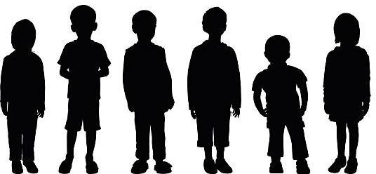
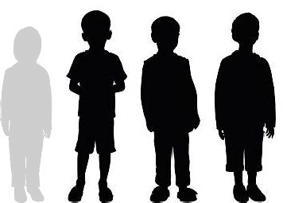
More kids survive cancer than ever before, but survivors have greater health risks for the rest of their lives.
Children should be closely followed in survivorship clinics.
It used to be that only
1 in 10 children
with leukemia survived for five years.
Now it’s 9 in 10 in high income countries
For some cancers, survival rates have not gotten much better.
Learner 7
C H I L D H O OD C ANC E R AND T H E E N V I R ONME N T

Slide 20
Having cancer can be very difficult for the child and family.
Years of medical tests and treatments. Time spent in the hospital.
Financial costs.
Child must be followed for treatment related health problems for the rest of life.
It is very stressful for everyone.
■
■
■
■
According to the National Cancer Institute, "An individual is considered a cancer survivor from the time of diagnosis through the rest of life.”
Emphasize this:
All of the environmental chemical exposures we will be discussing in this training that increase the risk of childhood cancer are especially true for children who have survived cancer. These exposures can also be risks for other childhood diseases such as asthma and developmental disabilities.
Prompt for discussion:
Does anyone know a child who has had cancer? How has that affected the child and family?
Educator 8
P E D IA T R I C E N V I R ONME N T AL H E AL T H S P E C IAL T Y UN I T S

Slide 21
Having cancer can be very difficult for the child and family.
Learner 8
C H I L D H O OD C ANC E R AND T H E E N V I R ONME N T

Slide 22
Although the exact cause of any individual child’s cancer may be difficult to determine, many factors may contribute, including genetics, social environments and exposure to toxic chemicals in the environment.
Today we will focus on the environmental chemical exposures that increase the risk for childhood cancer.
Factors that may contribute to childhood cancer include the genes we inherit, our social and economic environments, our food and nutrition, infections, and exposure to toxic chemicals.
Educator 9
P E D IA T R I C E N V I R ONME N T AL H E AL T H S P E C IAL T Y UN I T S

Slide 23
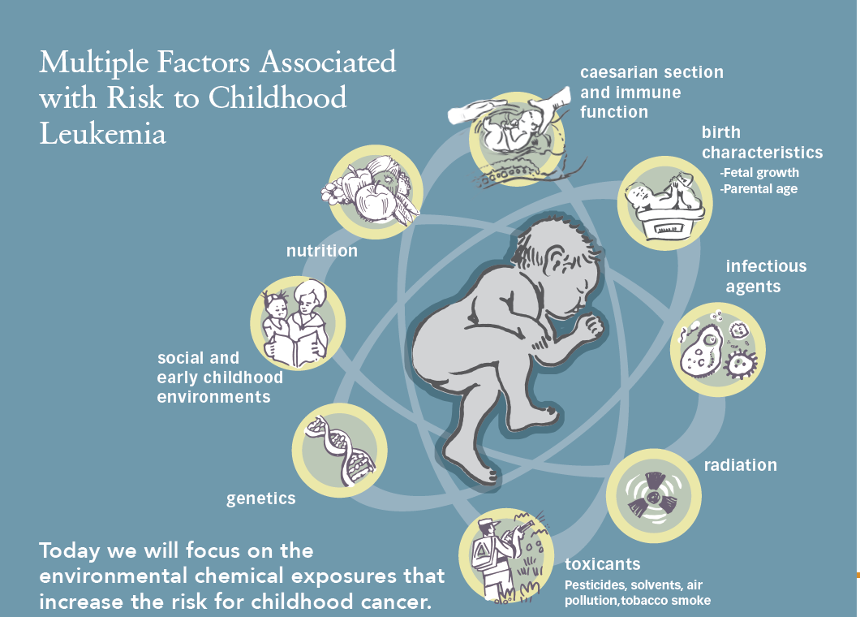
Multiple Factors Associated with Risk to Childhood Leukemia
caesarian section and immune
function
birth
characteristics
-Fetal growth
-Parental age
nutrition
infectious agents
social and
early childhood environments
radiation
genetics
Today we will focus on the environmental chemical exposures that increase the risk for childhood cancer.
toxicants
Pesticides, solvents, air pollution,tobacco smoke
Learner 9
C H I L D H O OD C ANC E R AND T H E E N V I R ONME N T

Slide 24
Why are kids more exposed to toxic chemicals?
Babies in the womb, kids and teens are both
more exposed to toxic chemicals because they eat, drink and breathe more for their size than adults
Young children put their hands in their mouths after touching the floor where dust and toxic chemicals gather.
they are more vulnerable to those exposures because they are growing and developing rapidly.
■
Educator 10
P E D IA T R I C E N V I R ONME N T AL H E AL T H S P E C IAL T Y UN I T S

Slide 25


Why are kids more exposed to toxic chemicals?
Pound for pound, children:
Drink more water, breathe more air and eat more food than adults
Put their mouths on more objects than adults
Have more skin covering their bodies than adults
Eat more dust than adults
Absorb more chemicals due to thinner skin than adults
Have more skin contact with the floor than adults
Learner 10
C H I L D H O OD C ANC E R AND T H E E N V I R ONME N T

Slide 26

Why are toxic chemicals more dangerous to kids than adults?
Babies in the womb, kids and teens are more vulnerable to these toxic chemicals because their bodies, especially their brains, are growing and developing rapidly. Development during these “windows of vulnerability” can be disrupted by very small amounts of chemical exposure. Adults have no similar “windows of vulnerability.”
Children are more likely to be harmed by toxic chemicals because they:
Toxic chemicals are more dangerous to children than adults.
Children are more likely to be harmed by chemicals because:
Children’s bodies are still developing and changing.
Hazardous chemicals can harm a child’s development, especially their brain development.
A child’s body is less able to get rid of some toxic chemicals than an adult’s because their organs are not yet fully functional like those of an adult.
Exposure to chemicals used in many homes, schools and child care settings where children spend most of their time have been shown to increase the risk of:
Learning Disabilities
Cancer
Birth defects
Early puberty
Hormonal disruption
Asthma and other respiratory ailments
Kidney disease
Have higher exposures to many chemicals
Are still developing and their bodies cannot get rid of toxic chemicals easily
■
Educator 11
P E D IA T R I C E N V I R ONME N T AL H E AL T H S P E C IAL T Y UN I T S

Slide 27
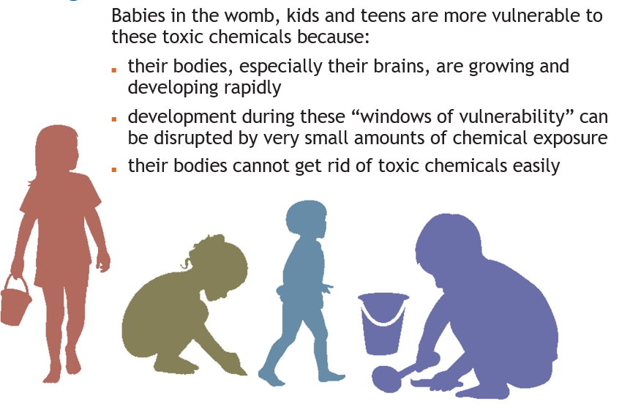
Why are toxic chemicals more dangerous to kids than adults?
Learner 11
C H I L D H O OD C ANC E R AND T H E E N V I R ONME N T

Slide 28
How are kids exposed to environmental hazards?
■
Children and adults may be exposed to environmental chemicals anywhere:
Indoors (at home, school, childcare, etc.), outdoors,
through air, water, soil and food.
>
>
■
Toxic chemicals can enter a person’s body through breathing, eating, drinking and through the skin.
Pregnant people can pass toxic chemicals from the mother to the child.
■
Early life exposures to environmental chemicals can have lifelong effects.
P E D IA T R I C E N V I R ONME N T AL H E AL T H S P E C IAL T Y UN I T S
Educator 12

Slide 29
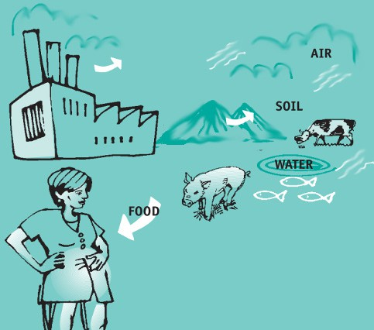




How are kids exposed to environmental hazards?
From the factory to the fetus and child
CHEMICALS
pathways
Learner 12
C H I L D H O OD C ANC E R AND T H E E N V I R ONME N T

Slide 30
What can we do to lower children’s risk?
Minimizing children’s exposure to environmental chemicals can lower their risk for childhood cancer and other health problems such as:
asthma,
learning disabilities, and immune system problems.
■
■
It’s also important to protect children who have been treated for cancer from these same exposures.
They are at higher risk for secondary cancers and other health problems later in life.
Let’s look at some ways we can protect them.
Educator 13
P E D IA T R I C E N V I R ONME N T AL H E AL T H S P E C IAL T Y UN I T S

Slide 31


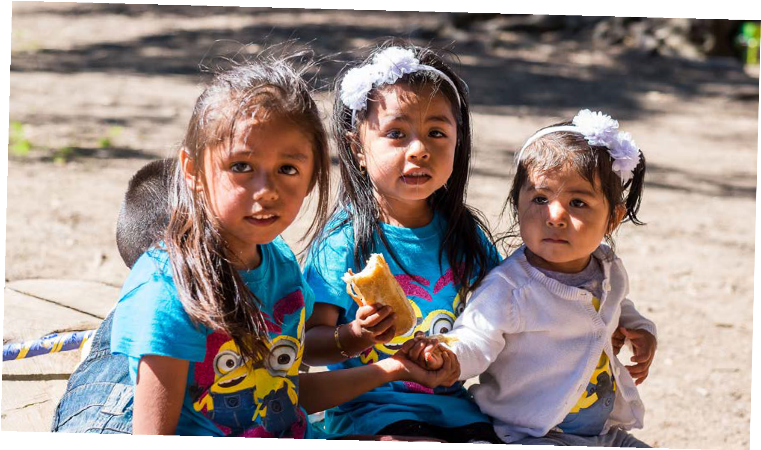
What can we do to lower children’s risk?
Minimizing children’s exposure to environmental chemicals can lower their risk for childhood cancer and other health problems. It’s also important to protect children who have been treated for cancer from these same exposures.
C H I L D H O OD C ANC E R AND T H E E N V I R ONME N T
Learner 13

Slide 32
You can start protecting your children’s health even before they are conceived, and during pregnancy.
Healthier choices include quitting smoking, eating healthier foods like lots of fruits and vegetables, and avoiding toxic chemicals in your home, workplace and play areas
Graphic reproduced with permission from the Center for Integrative Research on Childhood Leukemia and the Environment (CIRCLE)
Educator 14
P E D IA T R I C E N V I R ONME N T AL H E AL T H S P E C IAL T Y UN I T S

Slide 33
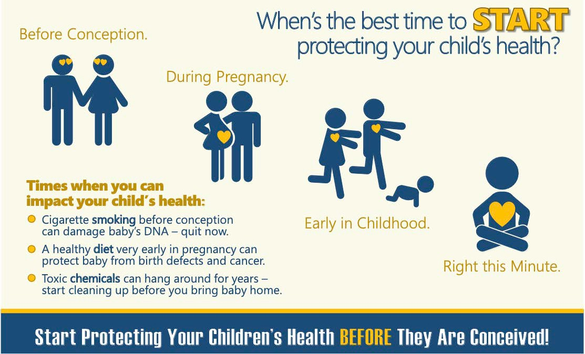
You can start protecting your children’s health even before they are conceived, and during pregnancy.
Learner 14
C H I L D H O OD C ANC E R AND T H E E N V I R ONME N T

Slide 34
You can start protecting your children’s health even before they are conceived, and during pregnancy.
Even before you get pregnant, and during pregnancy, it’s important to:
Eat healthy foods.
Take prenatal vitamins including your doctor’s recommended amount of folic acid (which is very important to prevent birth defects and protects babies from childhood cancer).
Eat lots of green leafy vegetables, beans, fresh fruits, and whole grains which are some foods with folate.
Avoid alcohol and caffeine.
Breastfeed - If it’s possible, breastfeeding for six months or longer is best after baby is born because it protects the baby from infections, provides important protective nutrients, and reduces the risk of childhood leukemia.
■
■
■
■
Prompt for discussion:
Discuss fresh foods that are culturally appropriate. Emphasize vitamins and folate. Provide resources if possible to healthy food programs such as the Women’s Infants and Children’s (WIC) food subsidy access.
Graphic reproduced with permission from the Center for Integrative Research on Childhood Leukemia and the Environment (CIRCLE)
Educator 15
P E D IA T R I C E N V I R ONME N T AL H E AL T H S P E C IAL T Y UN I T S

Slide 35
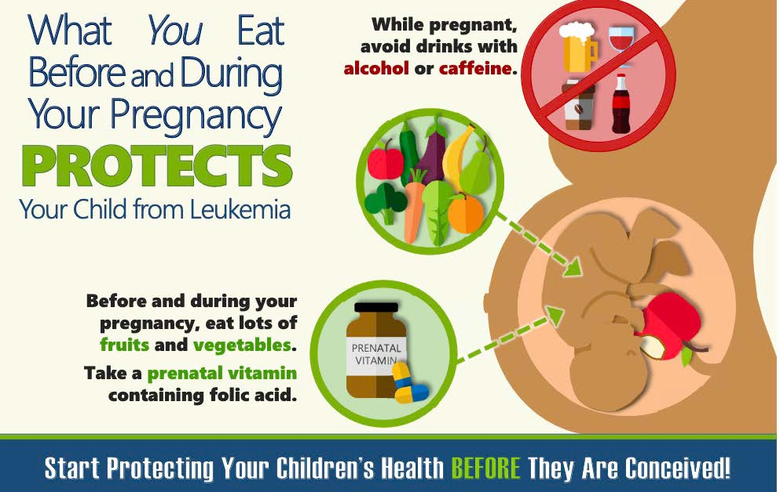
You can start protecting your children’s health even before they are conceived, and during pregnancy.
Learner 15
C H I L D H O OD C ANC E R AND T H E E N V I R ONME N T

Slide 36
Today we will focus on the following environmental exposures:
Outdoor air pollution
Indoor air pollution, including tobacco smoke Pesticides
Solvents/volatile organic compounds (VOCs)
■
■
■
We’ll be discussing preventive actions for each topic.
Educator 16
P E D IA T R I C E N V I R ONME N T AL H E AL T H S P E C IAL T Y UN I T S

Slide 37

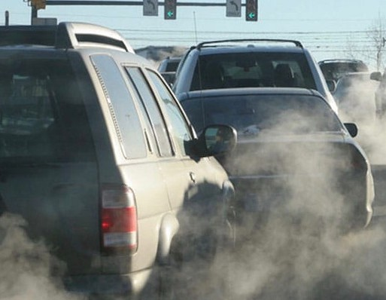
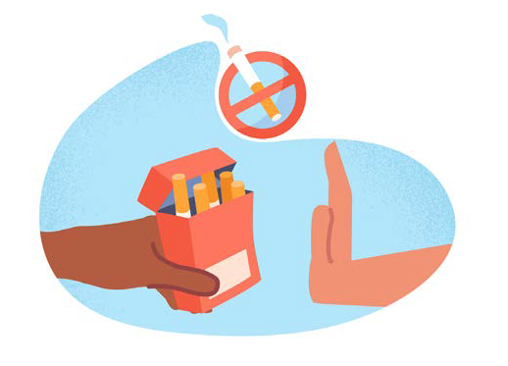
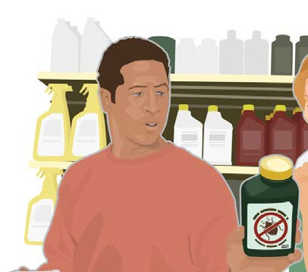
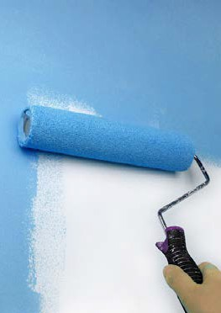

Today we will focus on the following environmental exposures:
We’ll be discussing preventive actions for each topic.
Outdoor air pollution
Indoor air pollution, including tobacco smoke
Solvents/volatile organic compounds (VOCs)
Pesticides
Learner 16
C H I L D H O OD C ANC E R AND T H E E N V I R ONME N T

Slide 38
Air pollution
What is outdoor air pollution?
Outdoor air pollution is caused by solid and liquid particles and cer- tain gases that can come from car and truck exhaust, factories, dust, pollen, mold spores, volcanoes and wildfires.
Exposure to exhaust from vehicles is a particularly concerning risk factor for childhood cancer.
Concern has been growing about living near oil and gas wells and the chemicals that they produce that can cause cancer.
■
■
Educator 17
P E D IA T R I C E N V I R ONME N T AL H E AL T H S P E C IAL T Y UN I T S

Slide 39

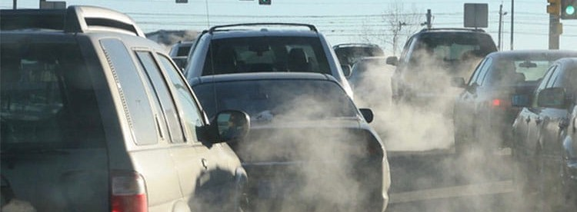
Air pollution
What is outdoor air pollution?
Outdoor air pollution is caused by solid and liquid particles and certain gases that can come from car and truck exhaust, factories, dust, pollen, mold spores, volcanoes and wildfires.
Exposure to exhaust from vehicles is a particularly concerning risk factor for childhood cancer.
Concern has been growing about living near oil and gas wells and the chemicals that they produce that can cause cancer.
■
■
Learner 17
C H I L D H O OD C ANC E R AND T H E E N V I R ONME N T

Slide 40
How you can decrease exposure to outdoor air pollution. Here are some tips.
■
Check the Air Quality Index (AQI) (airnow.gov) and limit outdoor activity when air quality
is poor. A rating in the “Green” is
considered good.*
■
Carpool, use public transporta- tion, or if the air quality is good outside and it is safe, bike or walk to reduce outdoor air pollu- tion from cars and other vehicles.
Avoid walking near idling vehicles.
Close windows during heavy traffic.
Maintain a working heating, ventilating and air conditioning (HVAC) system.
Scan the code to access airnow.gov.
■
Limit wood fires and backyard burning.
■
■
■
*Prompt for discussion:
Show how to use the AQI app.
Educator 18
P E D IA T R I C E N V I R ONME N T AL H E AL T H S P E C IAL T Y UN I T S

Slide 41


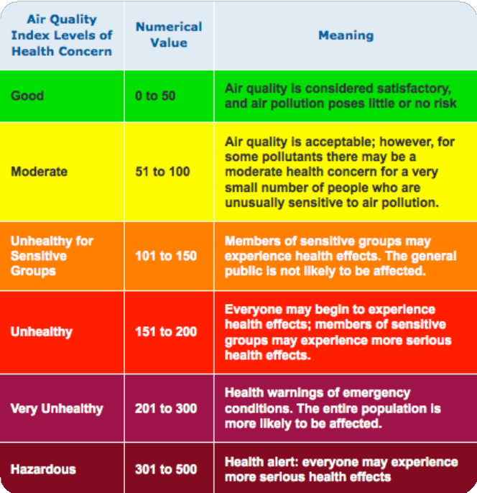
How you can decrease exposure to outdoor air pollution. Here are some tips.
■
Check the Air Quality Index (AQI) (airnow.gov)
Carpool, use public transit, and bike.
Limit wood fires and backyard burning.
Avoid walking near idling vehicles.
Close windows during heavy traffic.
■
■
■
■
Scan the code to access airnow.gov.
Learner 18
C H I L D H O OD C ANC E R AND T H E E N V I R ONME N T

Slide 42
How you can decrease exposure to wildfire smoke pollution. Here are some tips.
In the event of wildfires:
Keep children indoors with the doors and windows closed.
If you have an air conditioner, run it with the fresh-air intake closed (recir- culate mode).
Use portable air cleaners if available.
Have children wear an N95 or KN95 mask, but only if they are fitted tightly to the face. Use masks only for short periods when children must be outdoors.
Before being active outdoors, make sure the local air quality report has improved or the air no longer smells or looks smoky.
■
■
■
■
Educator 19
P E D IA T R I C E N V I R ONME N T AL H E AL T H S P E C IAL T Y UN I T S

Slide 43
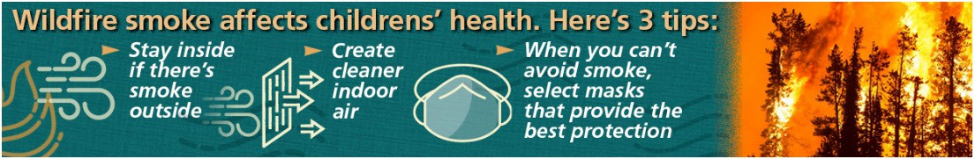

How you can decrease exposure to wildfire smoke pollution.
Here are some tips.
In the event of wildfires:
Keep children indoors with the doors and windows closed.
If you have an air conditioner, run it with the fresh-air intake closed (recirculate mode).
Use portable air cleaners if available.
Have children wear an N95 or KN95 mask, but only if they are fitted tightly to the face. Use masks only for short periods when children must be outdoors.
Before being active outdoors, make sure the local air quality report has improved or the air no longer smells or looks smoky.
■
■
■
■
Learner 19
C H I L D H O OD C ANC E R AND T H E E N V I R ONME N T

Slide 44
What is indoor air pollution?
Potential Sources of Indoor Air Pollution
chemicals released from modern building and furnishing materials including tapestries, electronics and the housing structure itself
combustion gases from fireplaces and wordburning stoves
animal hair & dander, pest droppings
chemical fumes from paints and solvents, air fresheners, incense and candles
gases including radon seeping through foundation
National Radon Hotline: 1-800-SOS-RADON
outdoor air pollutants mold & bacteria
chemicals from cleaning products
cooking-related emissions
carbon monoxide fumes from attached garage
cigarette smoke contains some 4,000 chemicals
■
■
■
■
■
■
■
■
Educator 20
P E D IA T R I C E N V I R ONME N T AL H E AL T H S P E C IAL T Y UN I T S

Slide 45
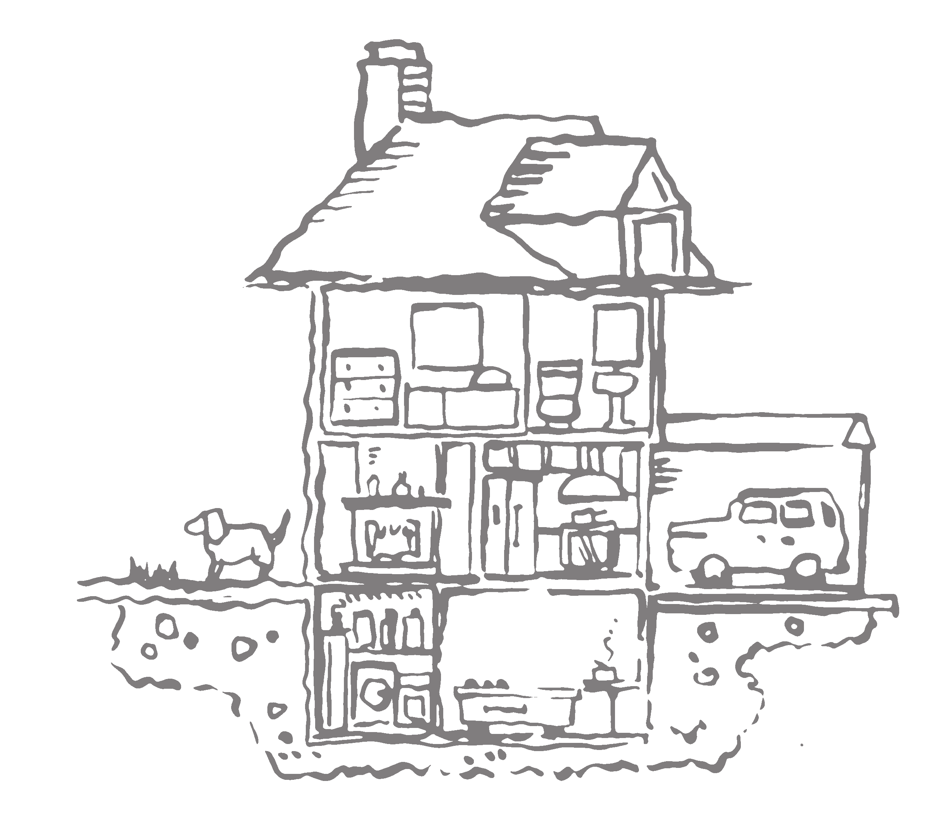
What is indoor air pollution?
Potential Sources of
Indoor Air Pollution
chemicals released from modern building & furnishing materials
outdoor air pollutants
mold & bacteria chemicals from
cleaning products
cooking-related emissions
combustion gases from fireplaces & woodburning stoves
carbon monoxide fumes from attached garage
animal hair
& dander, pest
droppings
chemical fumes from paints & solvents
cigarette smoke contains some 4,000 chemicals
Learner 20
mold & bacteria
gases including radon seeping
through foundation
C H I L D H O OD C ANC E R AND T H E E N V I R ONME N T

Slide 46
How you can decrease indoor air pollution
Limit sources of indoor air pollution such as tobacco smoke, cleaning products, air fresheners, candles, dust, emissions from gas stoves.
Clean the air through ventilation and filtration.
system filters regularly. Make sure you put them in the correct way. When possible, get regular maintenance to clean your HVAC systems.
Check the EPA Care for Your Air website for tips on improving indoor air quality.
Test your house for radon.
*What are HEPA filters?
HEPA are air filters which filter out more pollution particles. These filters are very helpful when the air quality outside is poor, or in wildfire season, when you can’t open the windows. (A “HEPA” filter is a high efficiency particulate air filter that can remove at least 99.97% of dust, pollen, mold, bacteria, and many other airborne particles.)
Educator 21
■
>
Open windows when weather and outdoor air quality permits,
Turn on exhaust fans when cooking, and
Filter indoor air with “HEPA” filter labeled MERV 11 or higher if possible.*
Use a vacuum cleaner with a HEPA filter.
Change your heating, ventilation and air conditioning (HVAC)
>
>
>
>
>
P E D IA T R I C E N V I R ONME N T AL H E AL T H S P E C IAL T Y UN I T S

Slide 47



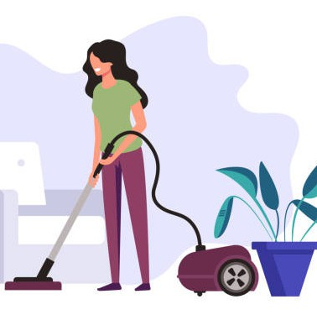
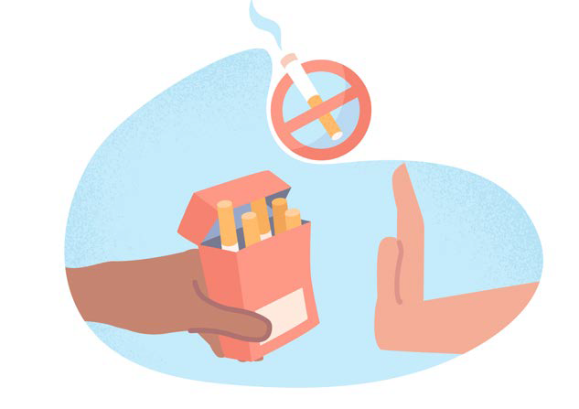
How you can decrease indoor air pollution
Limit sources of indoor air pollution such as tobacco smoke, cleaning products, air fresheners, candles, dust, emissions from gas stoves.
Clean the air through ventilation and filtration.
Learner 21
C H I L D H O OD C ANC E R AND T H E E N V I R ONME N T

Slide 48
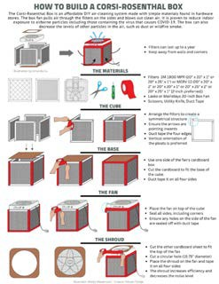
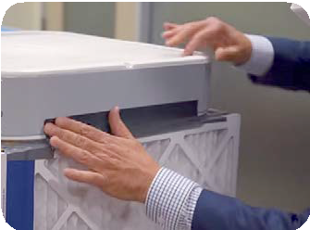
You can make your own indoor air filter.
These do-it-yourself boxes using a fan and 4 filters are much cheaper and more effective than most commercial air filters. To download the guide to make your own air filter, scan the QR code at right.
You can also watch a video demonstration, visit https://www.youtube.com/watch?v=hIuH-2naozI or scan the QR code below.
DIY air filter guide
DIY air filter video instuctions
Educator 22
P E D IA T R I C E N V I R ONME N T AL H E AL T H S P E C IAL T Y UN I T S

Slide 49
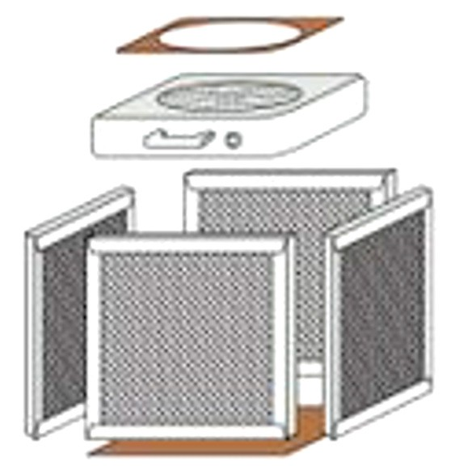
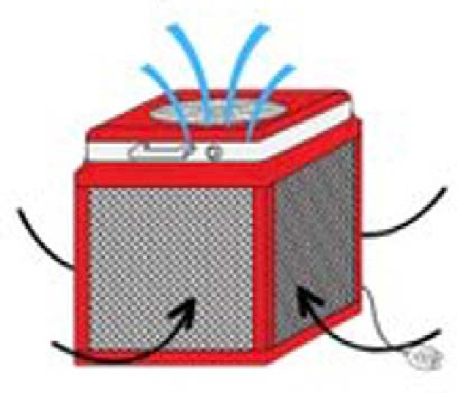
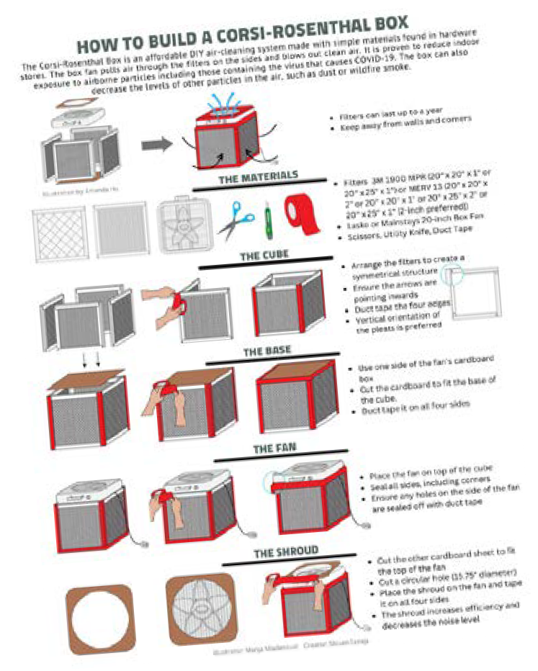
DIANA HU ILLUSTRATION
DIY air filter guide
You can make your own indoor air filter.
These do-it-yourself boxes using a fan and 4 filters are much cheaper and more effective than most commercial air filters. To download the guide to make your own air filter, scan the QR code above.
You can also watch a video demonstration, visit https://www.youtube.com/watch?v=hIuH-2naozI or scan the QR code at left.
DIY air filter video instuctions
Learner 22
C H I L D H O OD C ANC E R AND T H E E N V I R ONME N T

Slide 50
House dust is a magnet for toxic chemicals
This graphic shows that house dust is a magnet for toxic chemicals, some of which may be risks for childhood leukemia. Chemicals can get stuck to dust particles and remain in your home for years. Children tend to swallow dust because they’re on the floor a lot and they put their hands and toys in their mouths. One very easy thing you can do to protect your child is to keep your house clean and free of dust. Start cleaning up around your home before your baby is born.
Some practical tips for avoiding exposure to settled dust include:
Leave your shoes at the door so you don’t track in toxic chemicals and dirt.
Wash your child’s hands before eating.
Quit smoking/don’t smoke indoors (smoke particles can also stick to dust).
In addition:
Open windows, run fans especially while cleaning to increase airflow.
Keep dust levels down by damp dusting and mopping using microfi- ber cloths and mops.
Vacuum area rugs often with a
high-efficiency particulate air (HEPA) filter vacuum cleaner. These types of filters are able to trap extremely small particles of dust or chemicals.
We will cover safer cleaning products later on.
Graphic reproduced with permission from the Center for Integrative Research on Childhood Leukemia and the Environment (CIRCLE)
Educator 23
P E D IA T R I C E N V I R ONME N T AL H E AL T H S P E C IAL T Y UN I T S

Slide 51
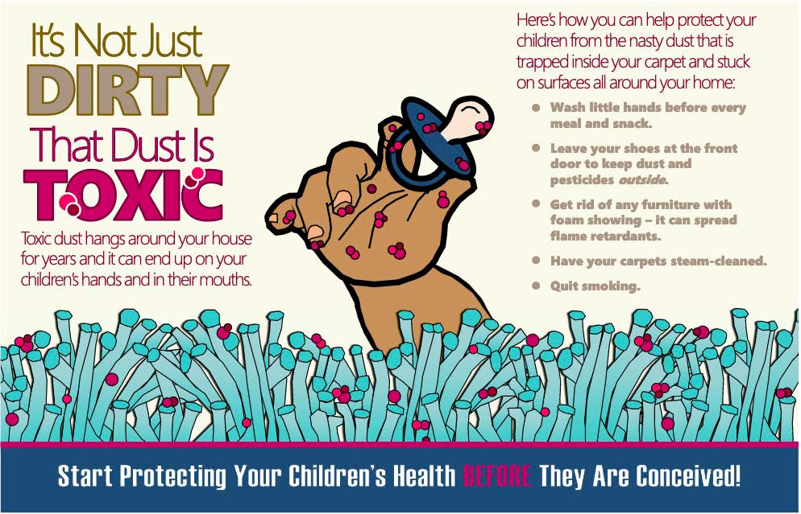
House dust is a magnet for toxic chemicals
Learner 23
C H I L D H O OD C ANC E R AND T H E E N V I R ONME N T

Slide 52
Indoor air: What’s in tobacco/vaping smoke; secondary, third-hand smoke
Tobacco smoke is made up of thousands of chemicals, including at least 70 known to cause cancer. These cancer-causing chemicals are referred to as carcinogens.
Some of the chemicals found in tobacco smoke include:
Nicotine ( the addictive drug in cigarettes)
Carbon monoxide Hydrogen cyanide Formaldehyde
Lead Arsenic Ammonia Benzene
■
■
■
■
■
■
Some of these chemicals can also cause heart disease, lung disease, or other serious health problems.
Ref: National Cancer Institute. (Scan code to access site.)
Educator 24
P E D IA T R I C E N V I R ONME N T AL H E AL T H S P E C IAL T Y UN I T S

Slide 53










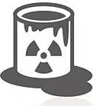




Indoor air: What’s in tobacco/vaping smoke; secondary, third-hand smoke
Stearic
Hexamine
barbecue lighter
Acid _{Cadmium} candle wax
batteries
Toluene
Butane
lighter
fluid
industrial
Nicotine
insecticide
solvent
Ammonia
toilet cleaner
Acetic Acid
vinegar
Tar
Methane
sewer gas
Methanol
rocket fuel
Arsenic
poison
Carbon Monoxide
Tobacco smoke is made up of thousands of chemicals, including at least 70 known to cause cancer. These cancer-causing chemicals are referred to as carcinogens.
C H I L D H O OD C ANC E R AND T H E E N V I R ONME N T
Learner 24

Slide 54
Dad’s smoking before pregnancy can harm the child too, including increasing the risk of his child getting leukemia.
From the graphic:
Mom’s smoking during pregnancy is bad for baby, but did you know that dad’s smoking before pregnancy can harm the child too?
Mom’s smoking during pregnancy can increase the risk of: premature birth, birth defects, or even miscarriage.
Dad’s smoking before conception can cause leukemia.
Moms or dads who smoke can increase cancer-causing DNA changes to their children by 30%.
Start protecting your children’s health before they are conceived!
■
■
■
■
Educator 25
P E D IA T R I C E N V I R ONME N T AL H E AL T H S P E C IAL T Y UN I T S

Slide 55











Mom’s Smoking During Pregnancy is Bad for Baby, but
Mom’s smoking during pregnancy can
cause: premature birth, birth defects, or even a miscarriage.
Dad’s smoking before conception can cause: childhood leukemia.
`
Moms or dads who smoke increase cancer-causing DNA changes in their children by 30%.
Learner 25
C H I L D H O OD C ANC E R AND T H E E N V I R ONME N T

Slide 56
The Dangers of Second-hand and Third-hand Smoke Exposure
Second-hand smoke exposure occurs when people breathe in smoke exhaled by other smokers, or from burning tobacco products.
Third-hand smoke is the chemical residue left behind after someone smokes. The residue can cling to clothes, hair and skin, floors, walls, bedding, curtains, toys, and other surfaces.
Second-hand and third-hand smoke contain harmful, toxic and cancer- causing chemicals that can be breathed in, absorbed through the skin, or swallowed, when children put their contaminated hands or other objects into their mouths.
Reduce or eliminate your kid’s exposure to tobacco smoke or vapors (including e-cigarettes and other vaping devices).
■
■
■
Do not allow smoking inside buildings or in the car. Help to quit smoking resources:
- Quitline (1-800-QUIT-NOW)
>
Educator 26
P E D IA T R I C E N V I R ONME N T AL H E AL T H S P E C IAL T Y UN I T S

Slide 57










The Dangers of Second-hand and Third-hand Smoke Exposure
Second-hand and third-hand smoke contain harmful, toxic and cancer-causing chemicals that can be breathed in, absorbed through the skin, or swallowed, when children put their contaminated hands or other objects into their mouths.
Reduce or eliminate your kid’s exposure to tobacco smoke or vapors (including e-cigarettes and other vaping devices).
■
Do not allow smoking inside buildings or in the car. Help to quit smoking resources:
- Quitline (1-800-QUIT-NOW)
>
Learner 26
C H I L D H O OD C ANC E R AND T H E E N V I R ONME N T

Slide 58
Pesticides – What are pesticides?
A pesticide is a poison that is designed to kill or control living things (pests) such as weeds (herbicides), insects (insecticides), rodents (like rats - rodenticides) or anything that you do not want to live in your home or yard, or in agricultural fields.
Roach and ant spray, flea bombs, rat poison, weed killer or mothballs are all examples of pesticides.
All pesticides are potentially harmful.
■
■
Educator 27
P E D IA T R I C E N V I R ONME N T AL H E AL T H S P E C IAL T Y UN I T S

Slide 59


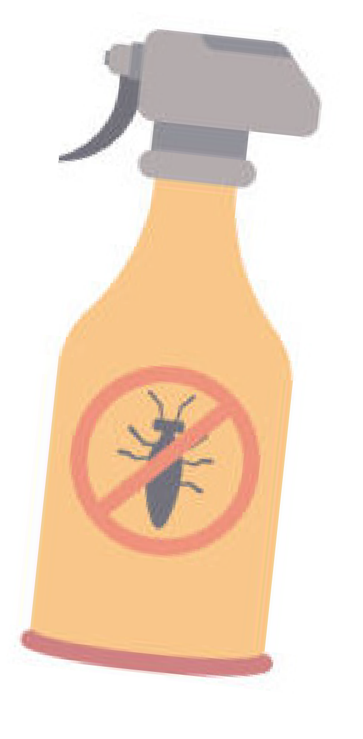
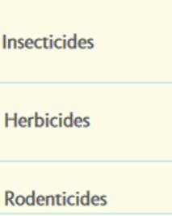
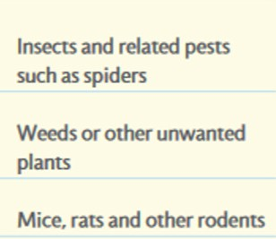
Pesticides – What are pesticides?
A pesticide is a poison that is designed to kill or control living things such as weeds, insect, and rodents.
Roach and ant spray, flea bombs, rat poison, weed killer or mothballs are all examples of pesticides.
All pesticides are potentially harmful.
■
■
Learner 27
C H I L D H O OD C ANC E R AND T H E E N V I R ONME N T

Slide 60
Why you should be careful about buying and using pesticides
Even though pesticides are widely available to buy, they can still be dangerous to children and adults.
Pesticides can contribute to poisoning or health effects right away (“acute effects”).
They can also cause illnesses or affect development long after exposure, sometimes decades later.
Pesticide exposure during pregnancy and early childhood has been linked to increased risk for getting leukemia, brain tumors, and other childhood cancers.
Fathers’ exposure to pesticides before conception has also been linked to their future child developing childhood leukemia.
■
■
■
Typically, the harmful effects of a pesticide depend on:
■
How poisonous it is. Some are more poisonous than others.
How long a person is in contact with the pesticide.
■
How much of the pesticide gets inside the body of the exposed person.
■
Pesticides can be swallowed, breathed in, or absorbed through the skin.
P E D IA T R I C E N V I R ONME N T AL H E AL T H S P E C IAL T Y UN I T S
Educator 28

Slide 61
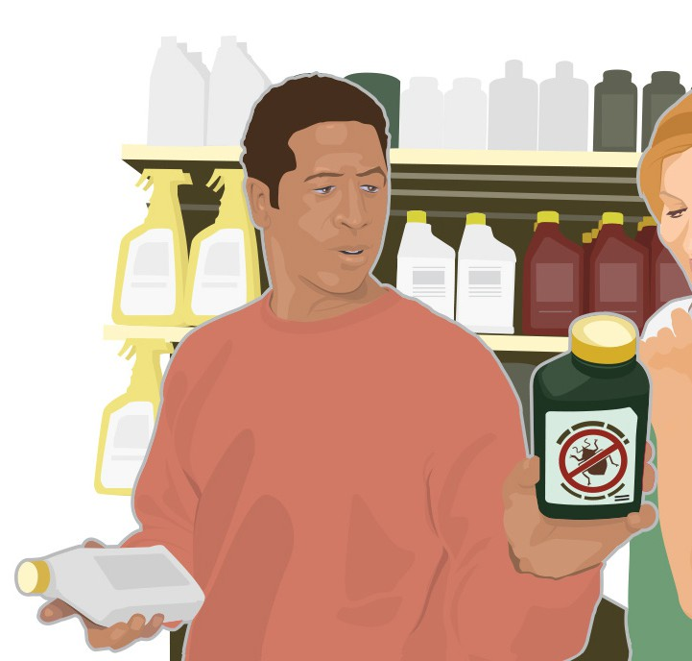


Why you should be careful about buying and using pesticides
Pesticides can cause poisoning or health effects right away (“acute effects”). They can also cause illnesses or affect development long after exposure, sometimes decades later.
Pesticide exposure during pregnancy and early childhood has been linked to increased risk for getting leukemias, brain tumors, and other childhood cancers.
Fathers’ exposure to pesticides before conception has also been linked to their future child developing childhood leukemia.
■
■
Learner 28
C H I L D H O OD C ANC E R AND T H E E N V I R ONME N T

Slide 62
Children and babies in the womb are especially at risk from pesticide exposure.
Possible long term health effects of pesticides include:
Asthma Cancers
Low birth weight and length Birth defects
Learning disabilities
Hormonal changes (disruption of the endocrine system)
■
■
■
■
■
From the graphic:
If a pesticide is present in air, food or water, a greater amount will be taken in by a child in proportion to their body size or weight than by an adult.
Educator 29
P E D IA T R I C E N V I R ONME N T AL H E AL T H S P E C IAL T Y UN I T S

Slide 63
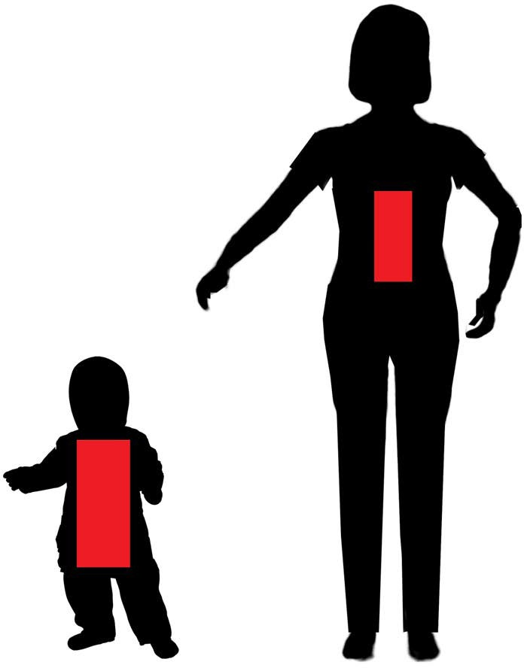
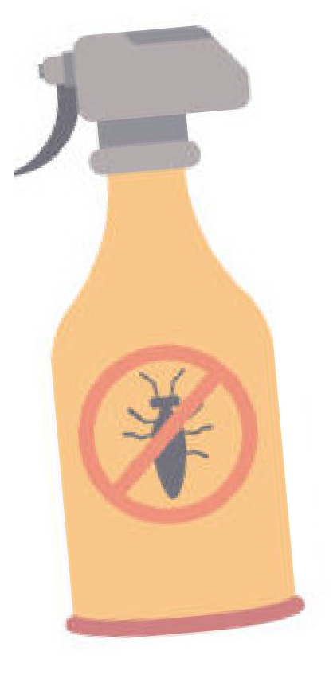
If a pesticide is present in air, food or water,
a greater amount will be taken in by a child in proportion to their body size or weight than by an adult.
Children and babies in the womb are especially at risk from pesticide exposure.
Learner 29
C H I L D H O OD C ANC E R AND T H E E N V I R ONME N T

Slide 64
Decrease pesticide exposure from food.
How you can decrease your exposure to pesticides
Wash and scrub produce with water.
Throw away the outer leaves of leafy vegetables where pesticide residues are highest.
Trim the skin and fat from poultry, fish and meats where pesticides can collect.
Purchase organic foods when possible, but not at the expense of a diet rich in a variety of fresh fruits and vegetables.
Search the Environmental Working Group (EWG) “Shopper’s Guide to Pesticides in Produce” (Dirty Dozen/Clean 15) tool to help make decisions about choosing organic produce.
■
■
■
■
DIRTY DOZEN / CLEAN 15
Scan the code to download the Environmental Working Group (EWG) “Shopper’s Guide to Pesticides in Produce”
Educator 30
P E D IA T R I C E N V I R ONME N T AL H E AL T H S P E C IAL T Y UN I T S

Slide 65
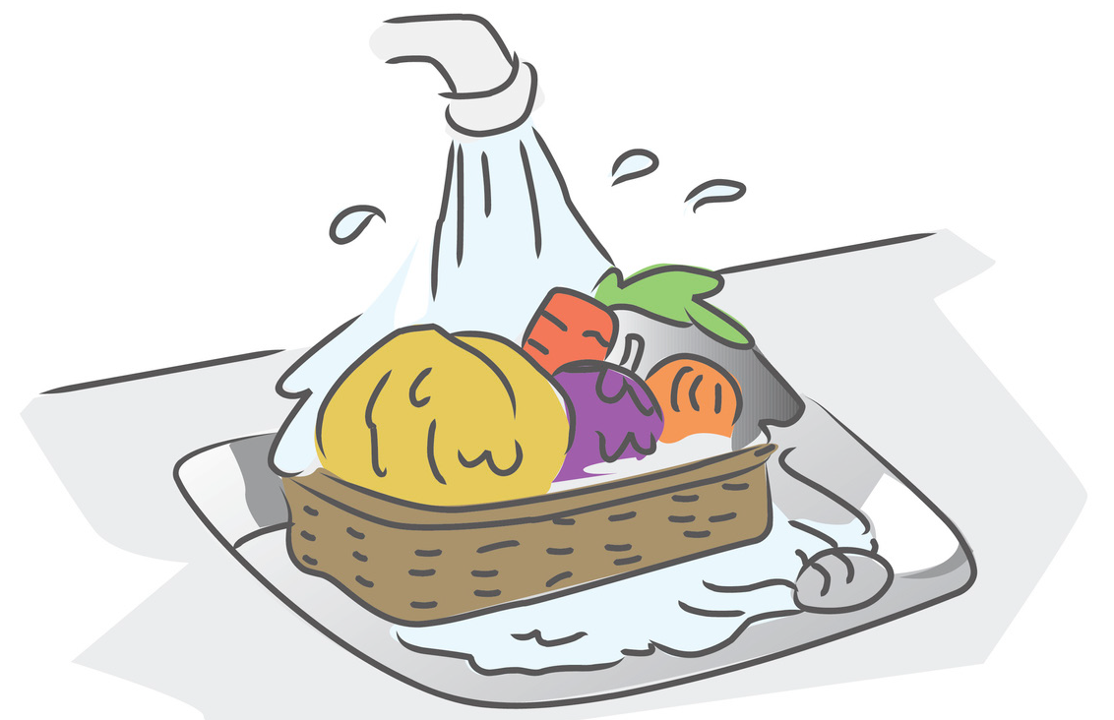

How you can decrease your exposure to pesticides
Decrease pesticide exposure from food.
DIRTY DOZEN / CLEAN 15
Scan the code to download the Environmental Working Group (EWG) “Shopper’s Guide to Pesticides in Produce”
Learner 30
C H I L D H O OD C ANC E R AND T H E E N V I R ONME N T

Slide 66
Decrease pesticide exposure in and around the home, school or child care.
How you can decrease your exposure to pesticides

Use the least toxic options possi- ble to control pests in and around buildings.
Learn about “Integrated Pest Management” (IPM), which involves chemical use only after several other steps are taken to remove pests from the home.
Check out the resources for more information.
Leave shoes outside your home to prevent tracking in pesticides and other contaminants on shoes.
Wash hands with soap and water often, especially before eating. Consider using a nail brush.

Read warnings on labels and always follow instructions when pesticides are used.
If pesticides are being applied outdoors nearby, shut windows and doors to prevent it from drifting indoors.
If hiring a professional pest control company, search for licensed companies that practice IPM and ask for the name(s), ingredient(s) and potential hazards of any products they will be using.
Choose a pesticide of lowest toxicity; always be sure products are EPA registered.






Prompt for discussion: Include local resources on Healthy Homes
Educator 31
P E D IA T R I C E N V I R ONME N T AL H E AL T H S P E C IAL T Y UN I T S

Slide 67

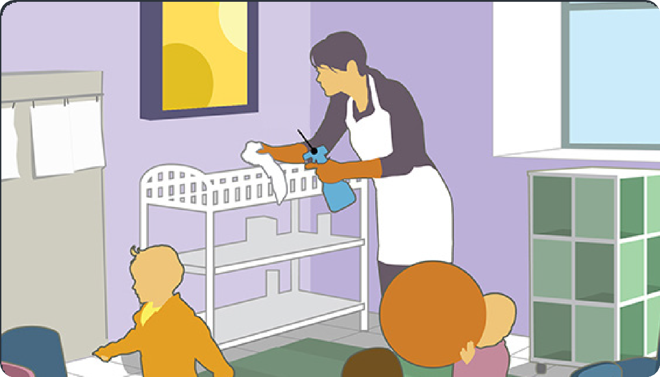
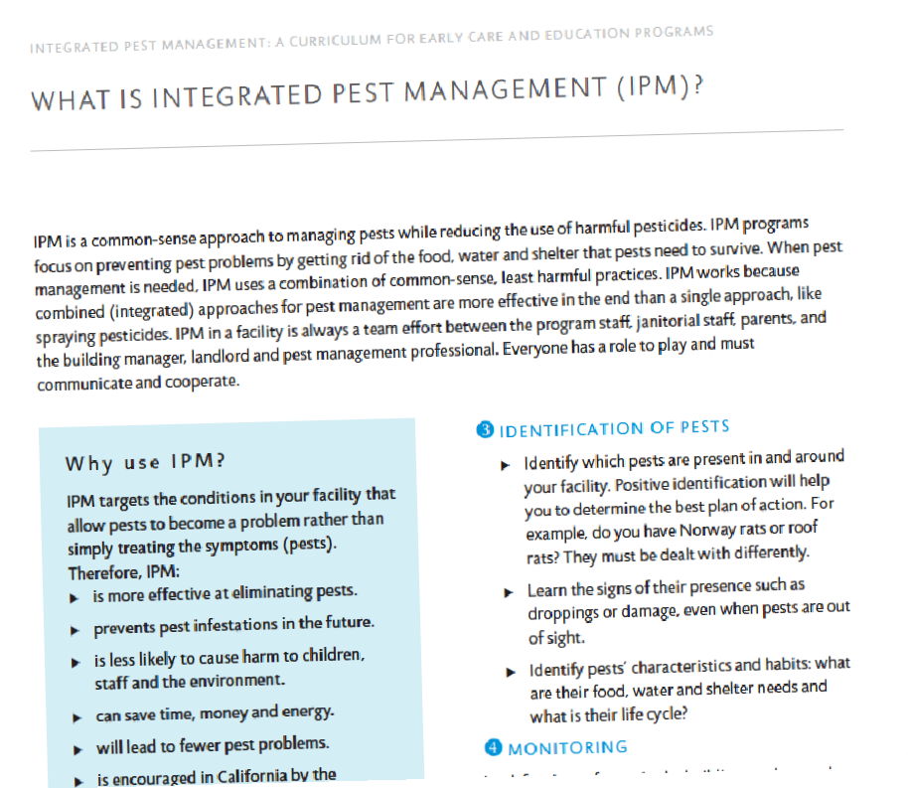

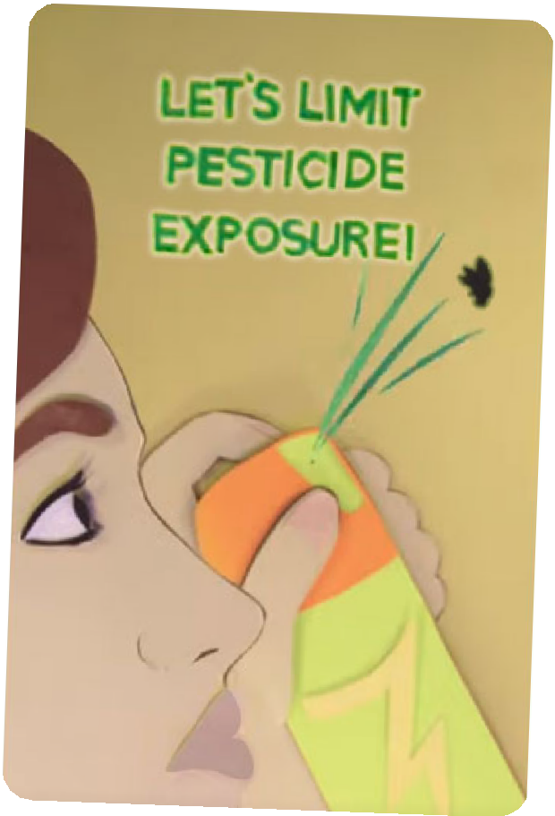



Decrease pesticide exposure in and around the home, school, or child care.
Learn more about IPM – see these fact sheets in English and Spanish.
Video: Simple steps to keep pests out of your home.
English
Spanish
English
Spanish
Learner 31
C H I L D H O O D C A N C E R A N D T H E E N V I R O N M E N T

Slide 68
If someone in your family works with pesticides they can bring home residues on hands and clothes (what we call “take home exposures”).
How you can decrease your exposure to pesticides
Pesticide residues can stick to skin, clothing, hair, and equipment and can remain on surfaces long after pesticides are applied. You can’t always see and feel the residues. If someone in your family works with pesticides or other chemicals, here are some tips for avoiding “take home exposures”:
Change your clothes at work and shower before you leave work.
Remove your shoes at the door before entering your home.
Wash your hands when you get home.
Launder work clothes separately.
Don’t use chemicals at home that are meant to be used in the workplace.
■
■
■
Educator 32
P E D IA T R I C E N V I R ONME N T AL H E AL T H S P E C IAL T Y UN I T S

Slide 69

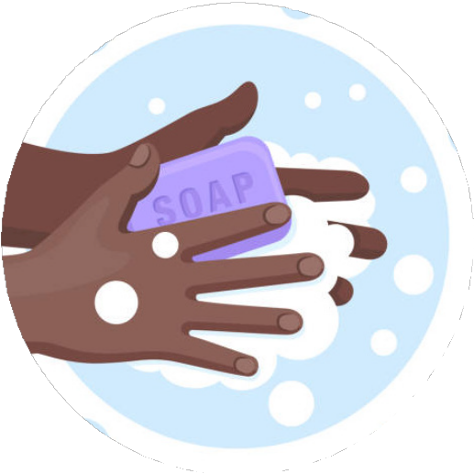
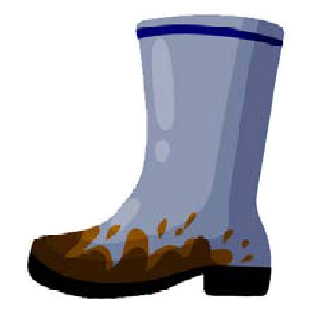
How you can decrease your exposure to pesticides
Here are some tips for avoiding “take home exposures”:
Change your clothes at work and shower before you leave work.
Remove your shoes at the door before entering your home.
Wash your hands when you get home.
Launder work clothes separately.
Don’t use chemicals at home that are meant to be
■
■
■
used in the workplace.
Learner 32
C H I L D H O OD C ANC E R AND T H E E N V I R ONME N T

Slide 70
What are Solvents and Volatile Organic Compounds (VOCs)?
VOCs and solvents are chemicals that are widely used as ingredients in household and personal care products. We are exposed by inhaling the vapors. Solvents can also be absorbed through your skin or mouth.
Examples of products containing solvents/VOCs that people can be exposed to:
Paints, lacquers, paint strippers, adhesive remover
Cleaning and disinfecting products, ‘odor-masking’ products, dry cleaning
Personal care products, cosmetics (ex. nail polish and remover, hair spray, perfume/ cologne)
Fuel (ex. gasoline, kerosene)
Pesticides
Building materials and furnishings
Crafting materials like glues & adhesives, permanent markers, photography solutions
■
■
■
■
■
Educator 33
P E D IA T R I C E N V I R ONME N T AL H E AL T H S P E C IAL T Y UN I T S

Slide 71

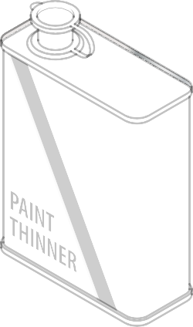

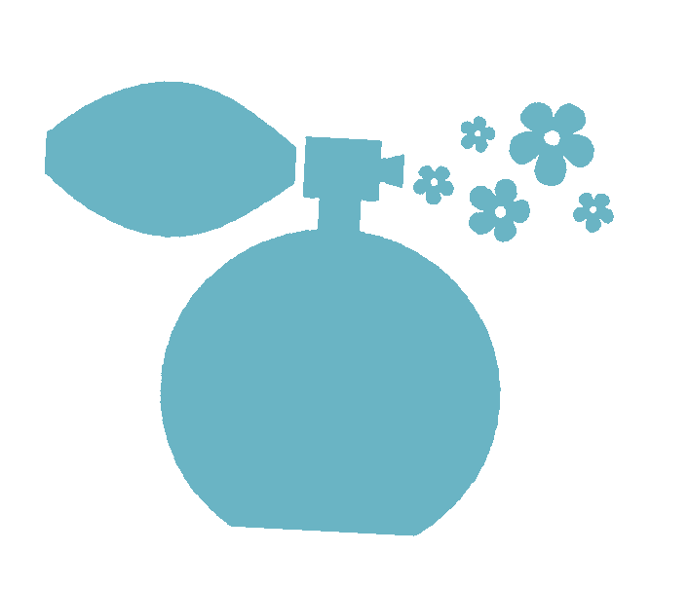




What are Solvents and Volatile Organic Compounds (VOCs)?
VOCs and solvents are chemicals that are widely used as ingredients in household and personal care products. We are exposed by inhaling the vapors. Solvents can also be absorbed through your skin or mouth.
Learner 33
C H I L D H O OD C ANC E R AND T H E E N V I R ONME N T

Slide 72
How you can lower your exposure to harmful solvents/VOCs.
Shop Smart: Look for these logos when buying household products. These logos tell you that the products have been tested for effectiveness and safety for human health and the environment.
Choose products labeled “Low- VOC”: Many products in these categories, like paints and personal care products, have Low-VOC alternatives (look on the label).
Choose unscented products and water-based glues or paints.
Safely dispose of any unneeded or unused products containing VOCs: If storing products for future use, store products in their original labeled containers, sealed, and away from the living space. Keep products locked and/or out of reach of children. Many of these products
are considered household hazardous waste and should be disposed of at special facilities.
Another way to lower VOC exposure is to avoid dry-cleaning clothes when possible, or look for dry-cleaners that provide ‘wet cleaning’ or ‘CO2 cleaning’ instead. Air out dry- cleaned clothing before storing or wearing.
■
■
■
Educator 34
P E D IA T R I C E N V I R ONME N T AL H E AL T H S P E C IAL T Y UN I T S

Slide 73

How you can lower your exposure to harmful solvents/VOCs.
Shop Smart: Look for these logos when buying household products. These logos tell you that the products have been tested for effectiveness and safety for human health and the environment.
Learner 34
C H I L D H O OD C ANC E R AND T H E E N V I R ONME N T

Slide 74
How you can lower your exposure to harmful solvents/VOCs (continued)
The concentration of many VOCs can be much higher – up to 10x higher – indoors compared to outdoors. People also spend a majority of their time inside, up to 90% – so it’s important to focus on a simple step to improve indoor air quality – letting the fresh air in!
Let the fresh air in!
space to sit unoccupied and ventilated for as long as possible.
Ventilation can help prevent these harmful gases from building up in the indoor air.
There are some circumstances in which the outdoor air can be more harmful than indoor air, like if there is wildfire smoke outside. In this case if you cannot ventilate your home safely, consider holding off on activities where you would use VOC-containing products (cleaning, painting, etc.) until the outdoor air is safer and you can ventilate your home appropriately.
■
Increase ventilation indoors by opening windows and doors, and using exhaust fans.
Examples of situations when increasing ventilation is important:
■
■
>
When using solvent/VOC contain- ing products indoors, like when cleaning or painting.
After installing new furniture, new carpeting, rugs or other textiles or products that contain VOCs such as manufactured pressed wood products (ex. new compos- ite wood flooring or furniture may contain formaldehyde), allow the
>
Educator 35
P E D IA T R I C E N V I R ONME N T AL H E AL T H S P E C IAL T Y UN I T S

Slide 75


How you can lower your exposure to harmful solvents/VOCs (continued)
Let the fresh air in!
The concentration of many VOCs can be much higher – up to 10x higher – indoors compared to outdoors. People also spend a majority of their time inside, up to 90% – so it’s important to focus on a simple step to improve indoor air quality – letting the fresh air in!
C H I L D H O OD C ANC E R AND T H E E N V I R ONME N T
Learner 35

Slide 76



For more information on the Childhood Cancer and the Environment program, visit the Western States PEHSU website.
https://wspehsu.ucsf.edu/
This flip book was supported by cooperative agreement FAIN: NU61TS000296 from the Centers for Disease Control and Prevention/Agency for Toxic Substances and Disease Registry (CDC/ ATSDR). The U.S. Environmental Protection Agency (EPA) provided support through Inter- Agency Agreement DW-75-95877701 with CDC/ATSDR. The American Academy of Pediatrics supports the Pediatric Environmental Health Specialty Units as the National Program Office. The findings and conclusions presented have not been formally disseminated by CDC/ATSDR or EPA and should not be construed to represent any agency determination or policy. Use of trade names that may be mentioned is for identification only and does not imply endorsement by the CDC/ATSDR or EPA.

